Slide 1

AX PRO Series Product
Online Operation Training
International Product and Solution Center
Notes:
封面
产品图可替换，配图无需更换

Slide 2










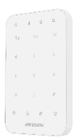














AX PRO System topology
Wired Input
433MHz
Radio Frequency
Remote and local programming option
ARC
Wireless zones
Internet
Wireless
Arming Tools
433MHz
Radio Frequency
Wireless Panel
Wireless Outputs
Mobile phone
SMS/Alarm call/APP
Wired Output
CCTV system

Slide 3









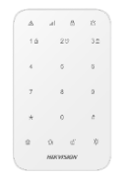


Villa Solution
IPC
Break Glass PIR
Outdoor Sounder
Keyfob
APP
AX PRO Hub
Magnetic Contact
PIR CAM
Keypad
Indoor Sounder
Panic Button

Slide 4




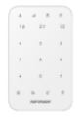



Villa Solution
Description | Model | Picture
AX PRO Kit | DS-PWA96-Kit-WB
Wireless PIR Break-Glass | DS-PDPG12P-EG2-WB
Wireless Panic Button | DS-PDEB1-EG2-WB
Wireless PIRCAM | DS-PDPC12P-EG2-WB
Wireless Keypad | DS-PK1-E-WB
Wireless Internal Sounder | DS-PS1-I-WB
Wireless External Sounder | DS-PS1-E-WB
IPC | Hikvision IP Camera & IPC with Onvif
Internal Use Only

Slide 5



01
Activing
AX PRO
Activing and Connect AX PRO into Network via Wi-Fi/LAN/SIM
Notes:
分类页

Slide 6


AX PRO Control Panel
System Status
Indicators
LAN Interface
(RJ45)
Power Switch
Power
Supply LED
Power
Supply
SIM card
Slots (2)
Tamper
Switch
Reset
Button
RS232 Port
Built-in Tag Reader
Front of AX PRO
Rear of AX PRO

Slide 7
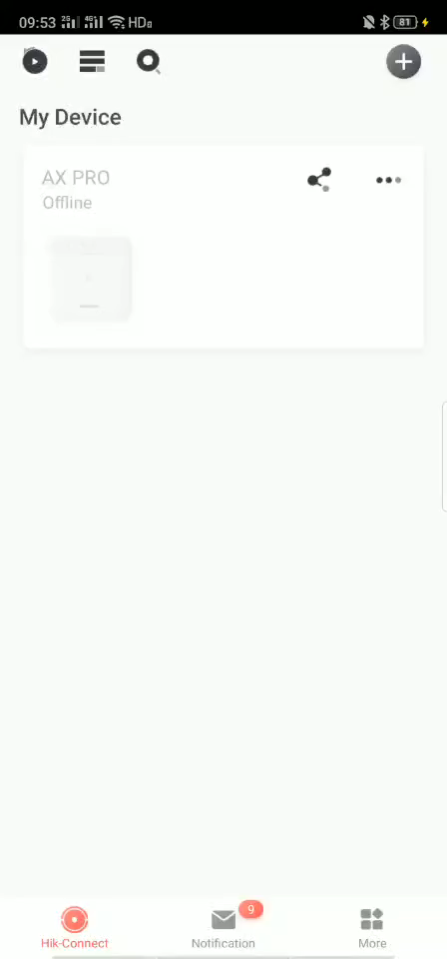
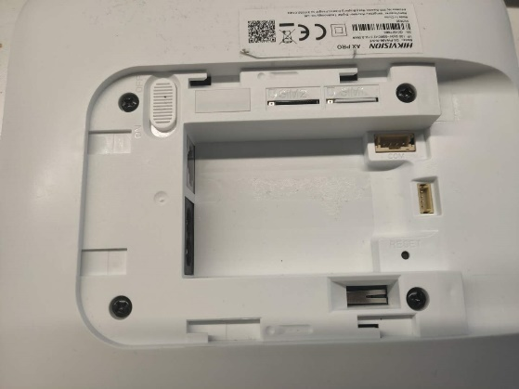
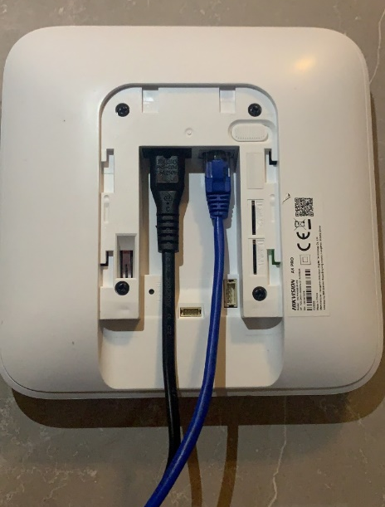
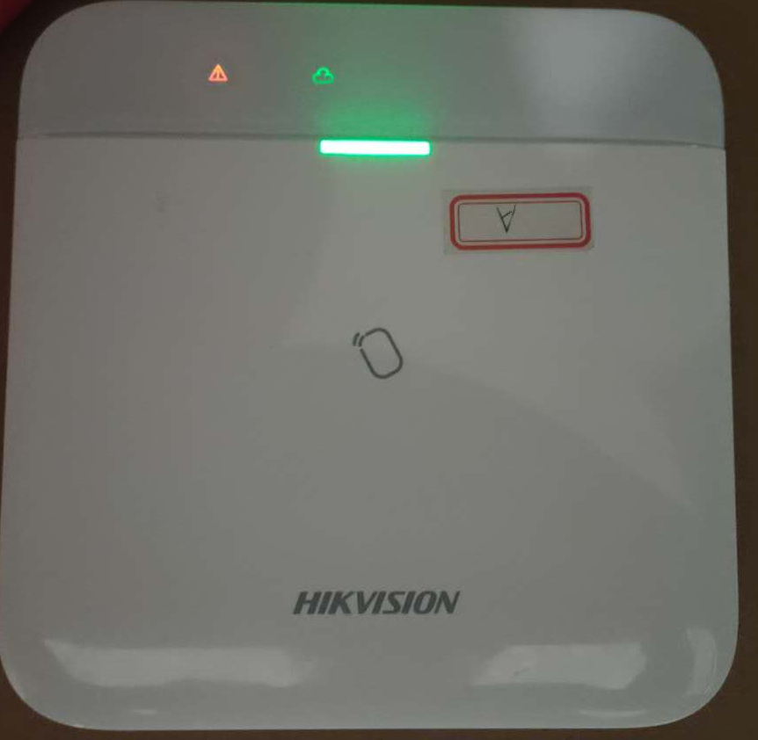
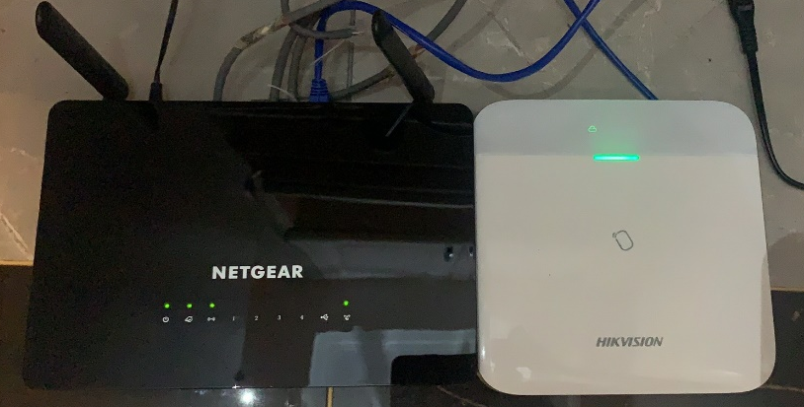
Adding AX PRO into Hik-Connect
Insert SIM card backboard
Cloud status indicator
Adding via Wi-Fi
(Option 1)
Adding via SIM Card
(Option 2)
Adding via LAN
(Option 3)

Slide 8
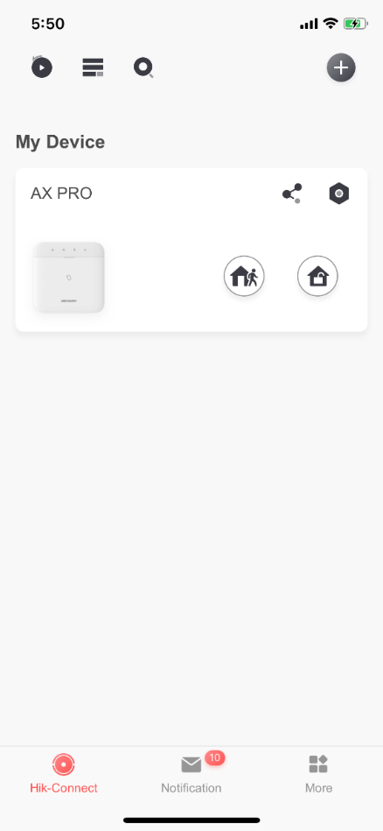
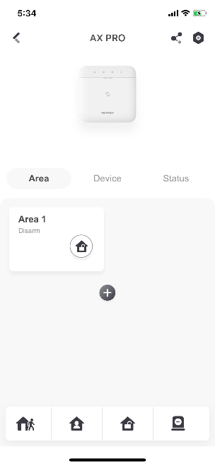
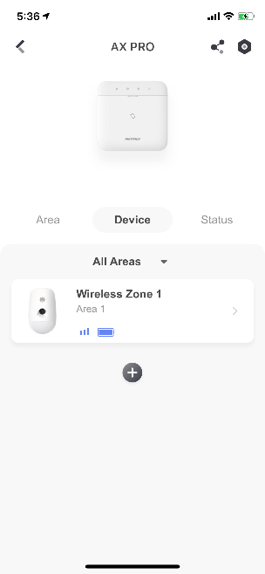
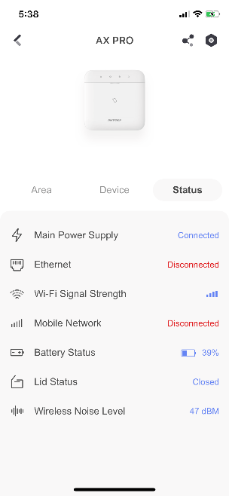
Area Interface
Device List
System Status
Dual buttons for Arming and Disarming
AX PRO has a more logical directory in Hik-Connect, which is divided into Area / Device / Status.
Besides, these readable icons also help us know more status of all the system, such as Area Arming Status, RF Signal Strength, battery life, and other system status.

Slide 9
02
Adding
Peripherals
Register wireless detectors and accessories into AX PRO panel
Notes:
分类页

Slide 10
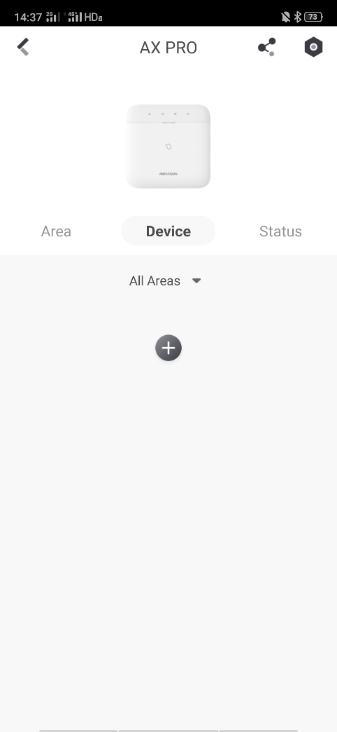
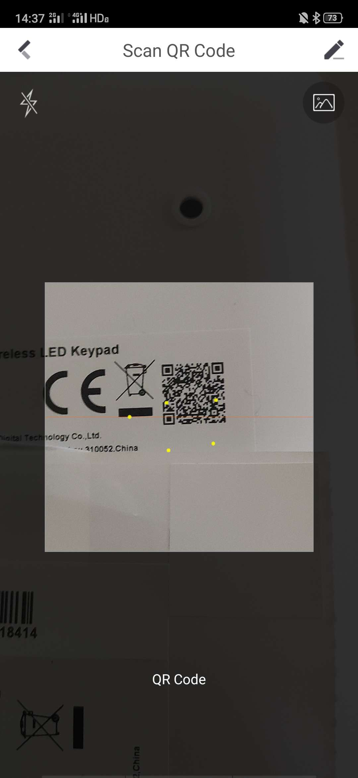
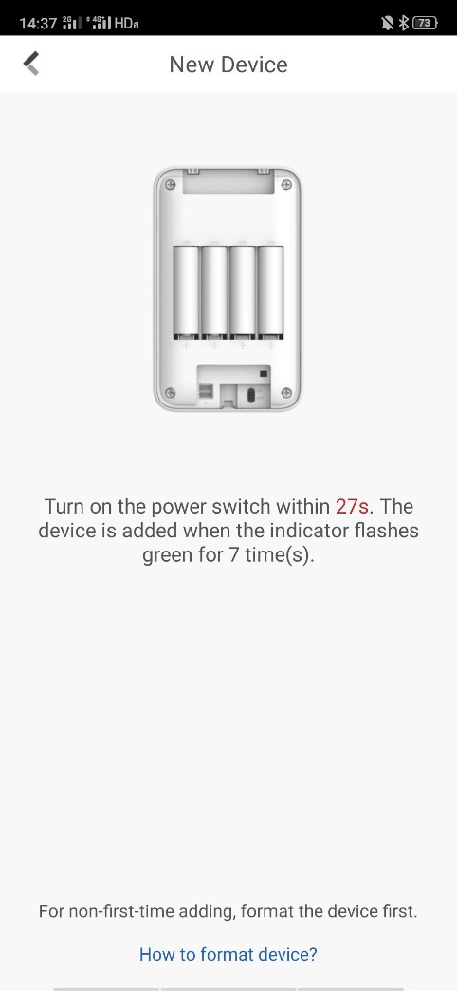
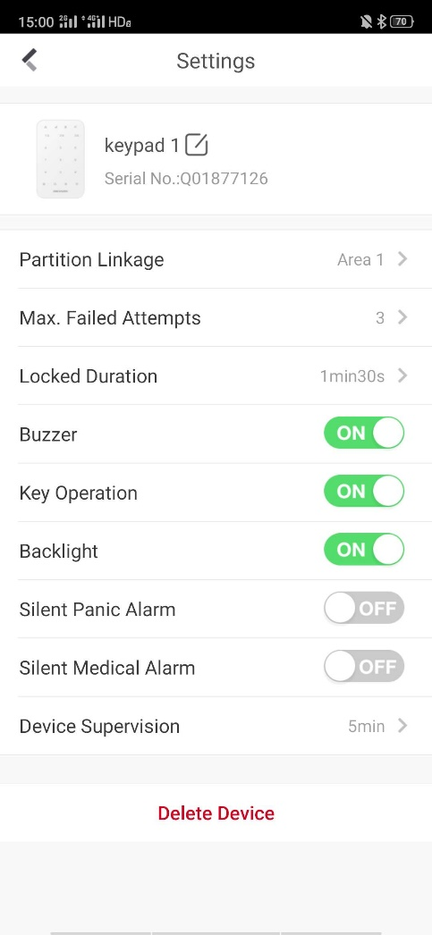
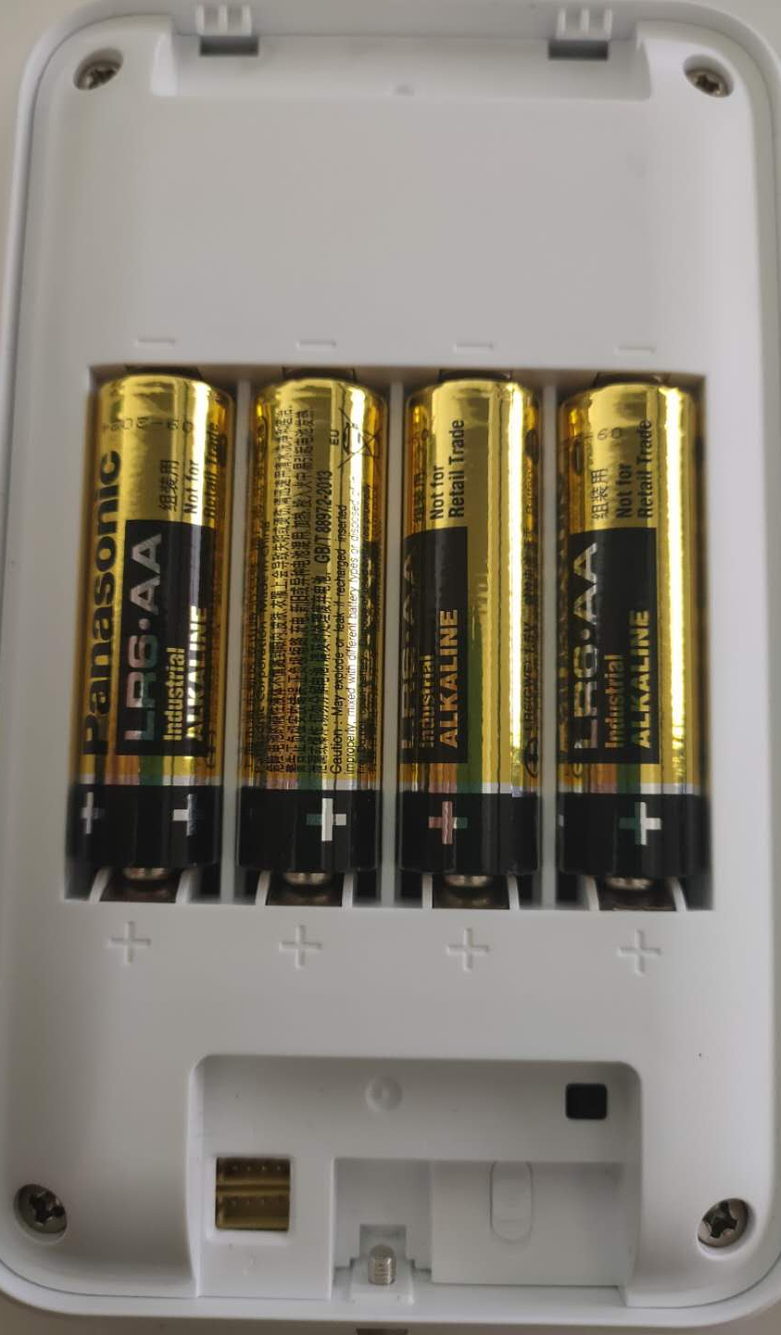
1.Adding Keypad
Power Switch
Press ‘+’ to add
Scan QR code of the keypad
Power up keypad and finish
Keypad Setting interface

Slide 11
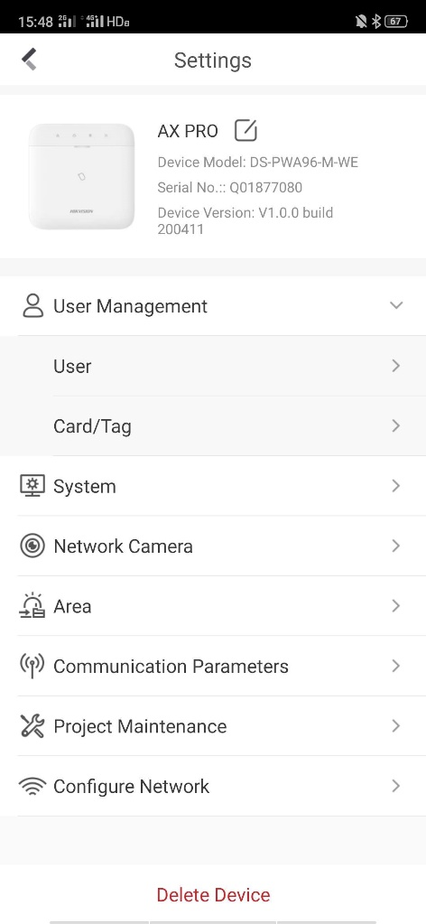
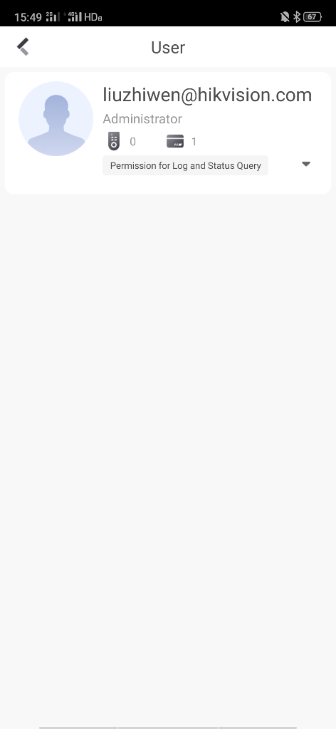
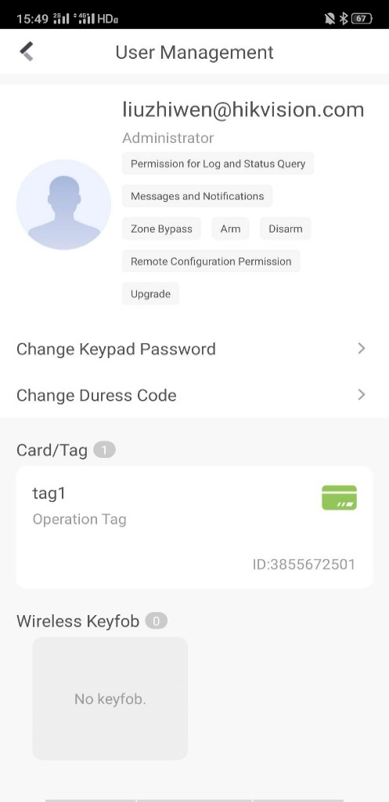
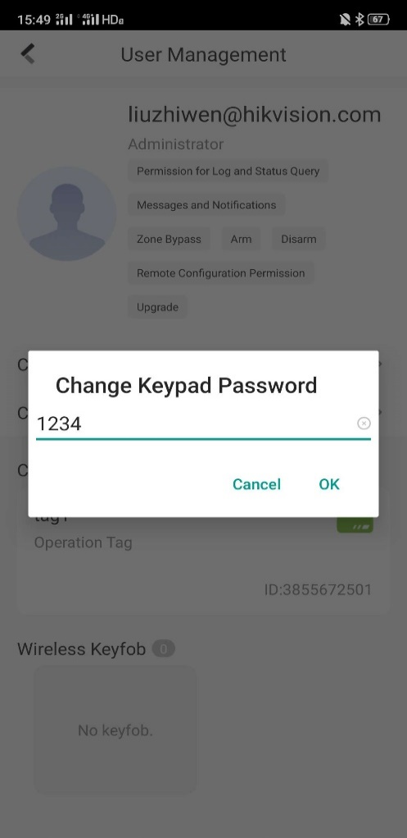
2.Setting Keypad Password
Press ‘user’ to
User interface
Turn to
User management site
“Change Keypad Password”
Set a password and press OK

Slide 12
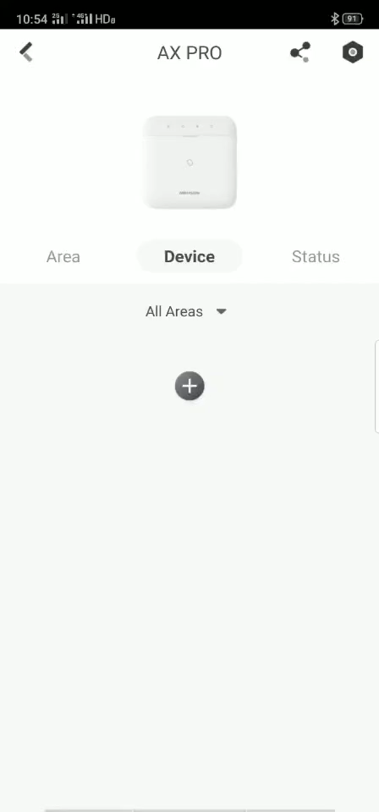
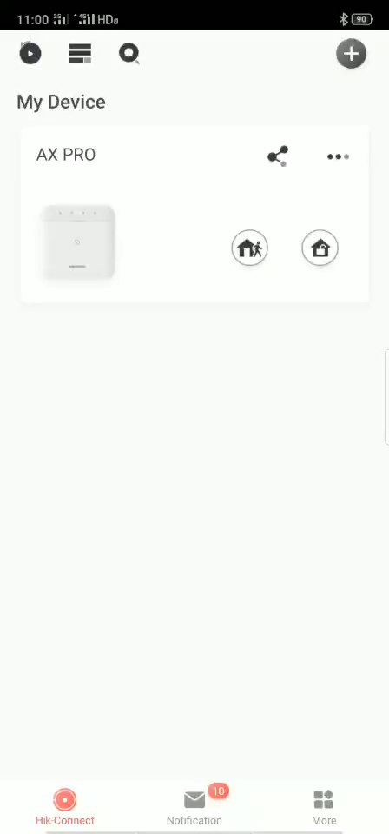
2.Keypad Operation Video
Adding Keypad
Setting Keypad Password

Slide 13
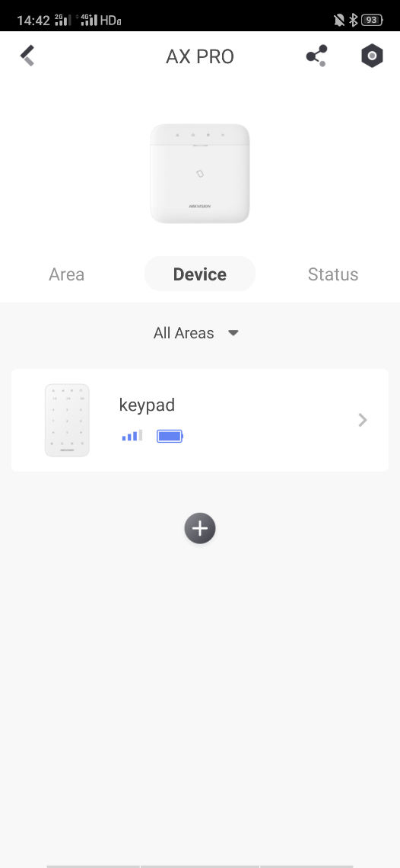
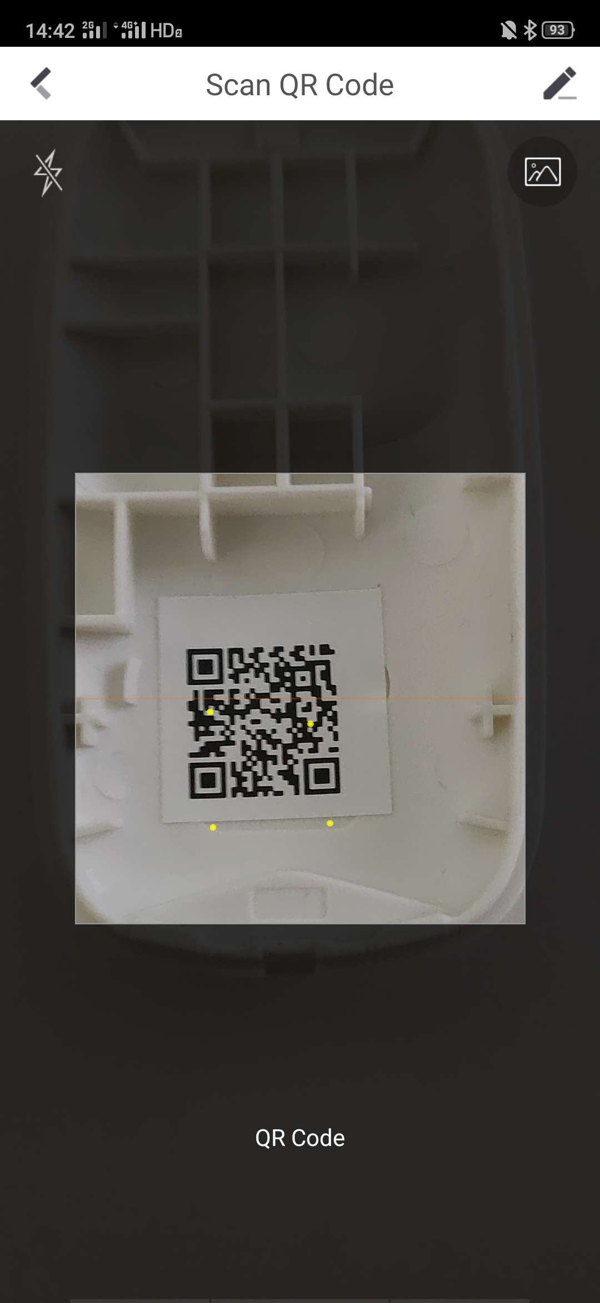
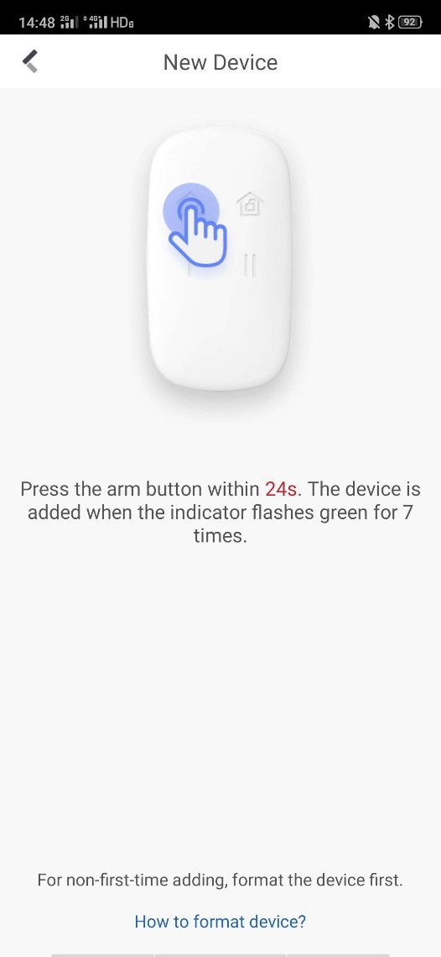
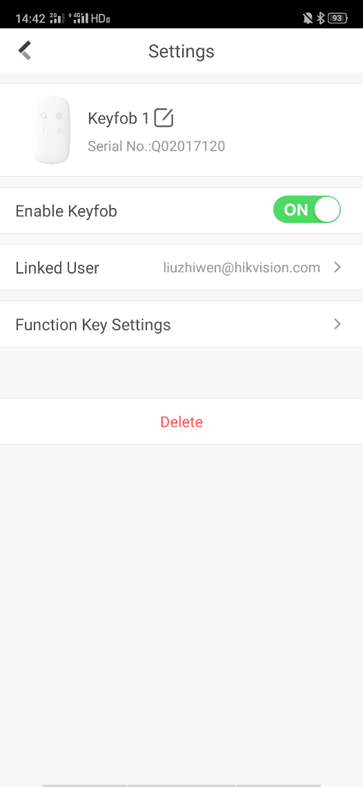
3.Adding Keyfob
Press ‘+’ to add
Scan the QR code of Keyfob
Press Arm button to add
Set and finish

Slide 14
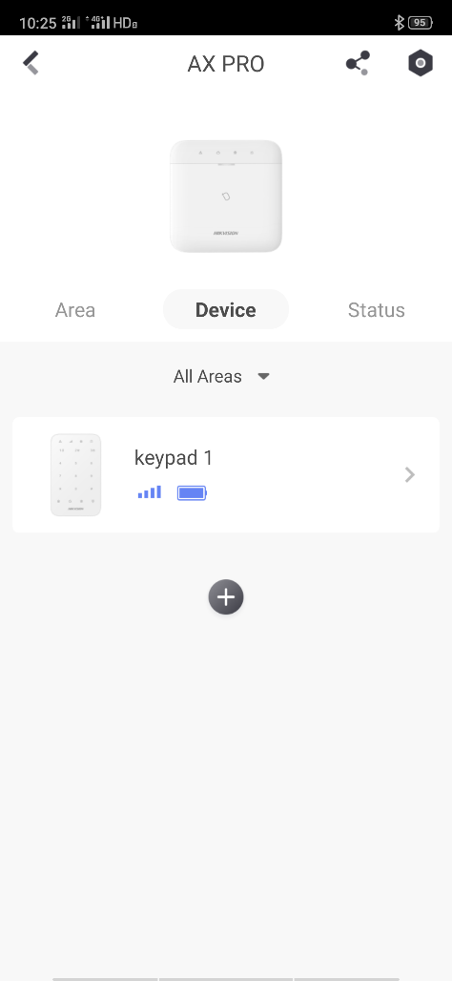
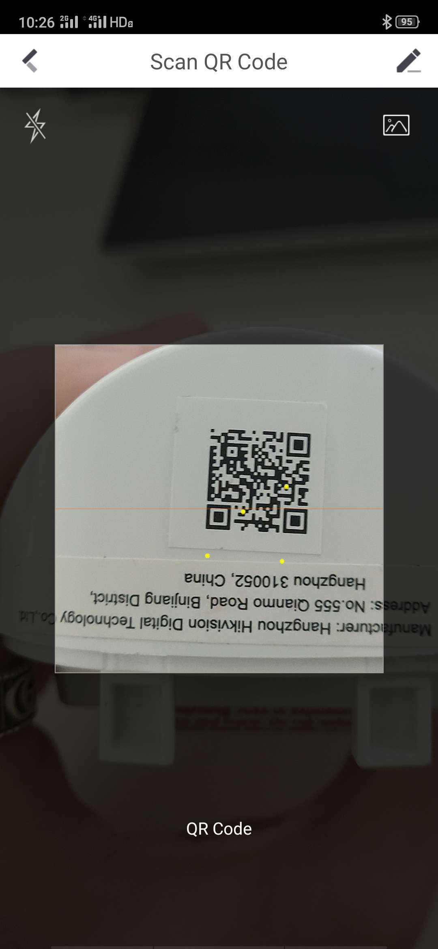
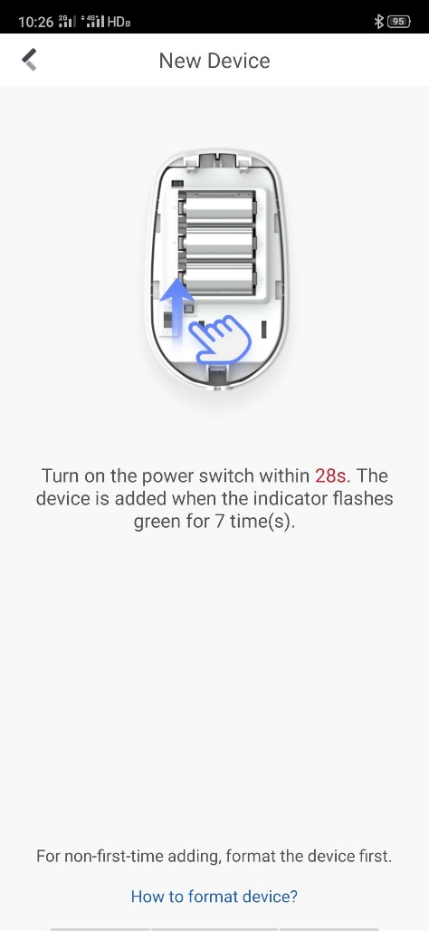
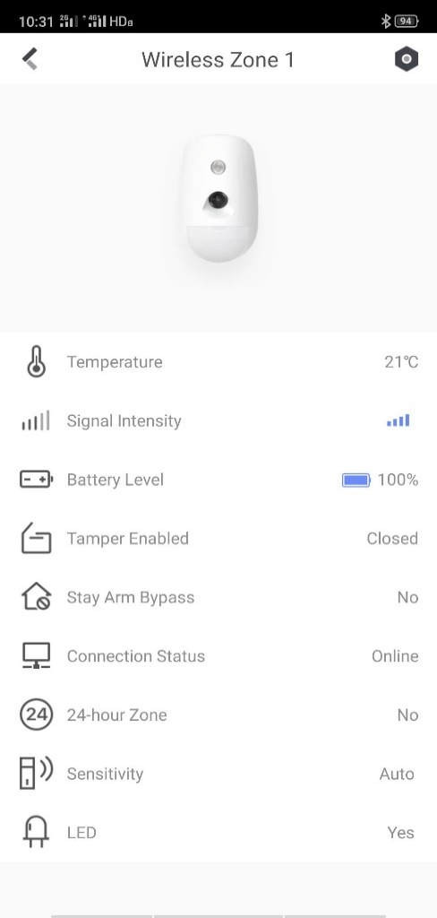
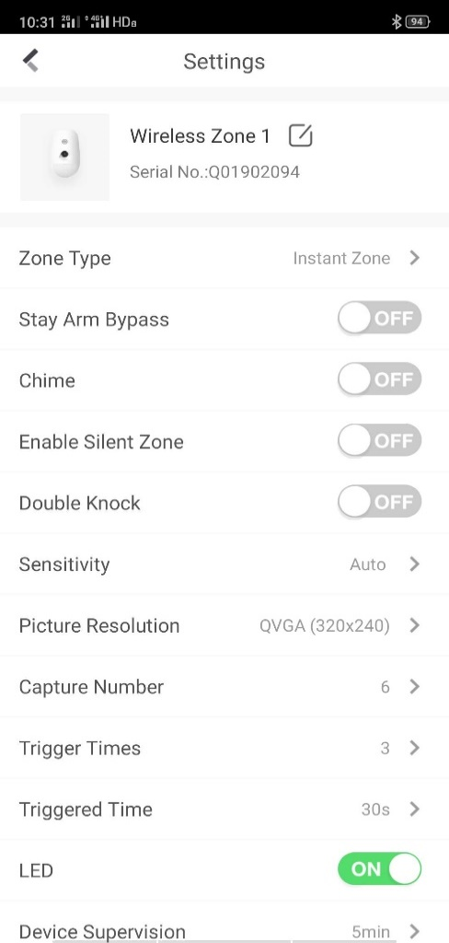
4.Adding Detector (e.g. PIRCAM)
Press ‘+’ to add
Scan the QR code of PIRCAM
Power up PIRCAM and finish
Press Setting Button to configure
PIRCAM Setting interface

Slide 15
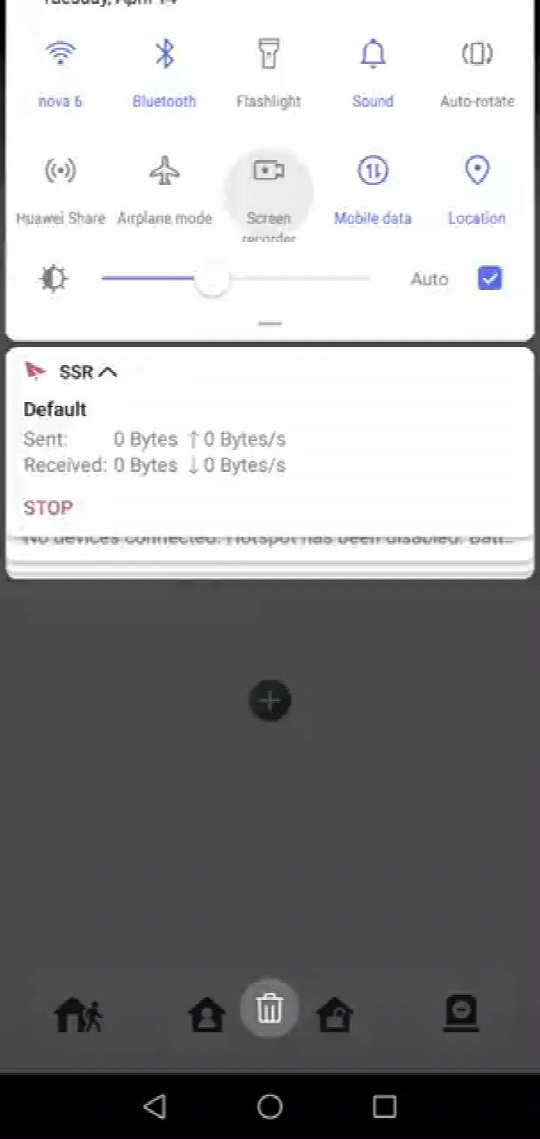
4.Adding Detector Video (e.g. PIRCAM)

Slide 16
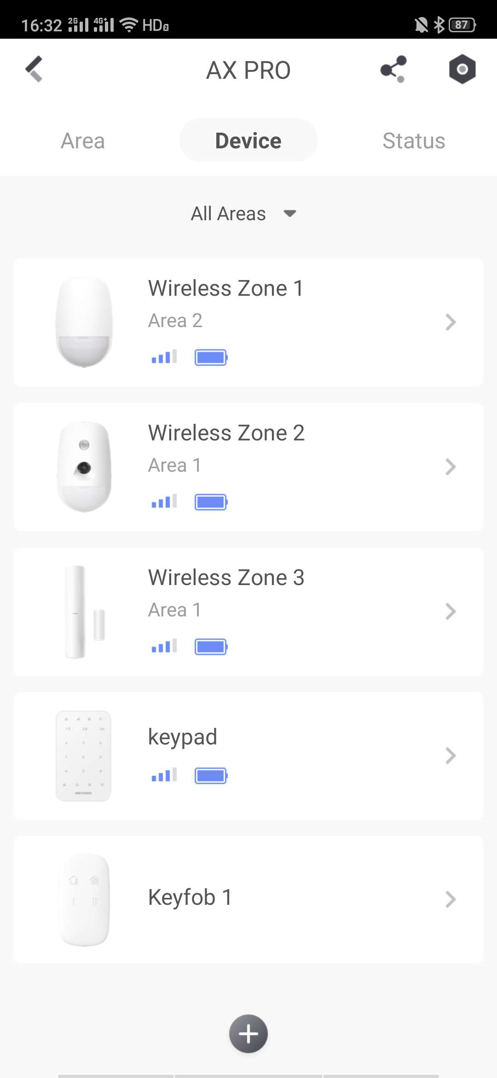
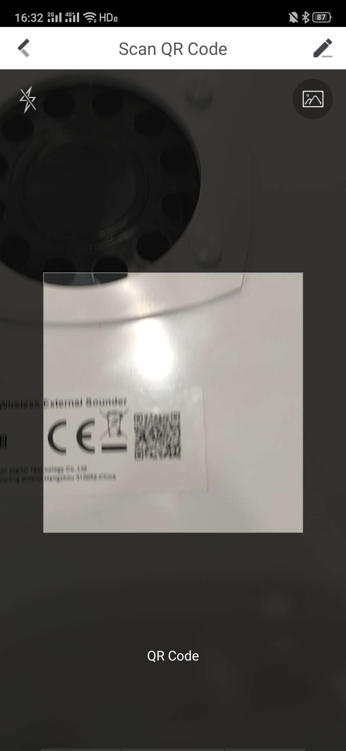
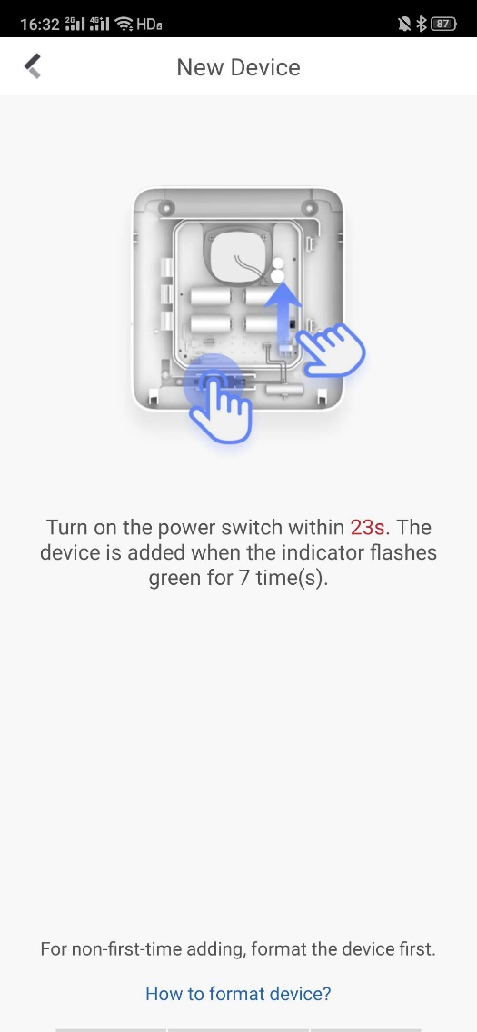
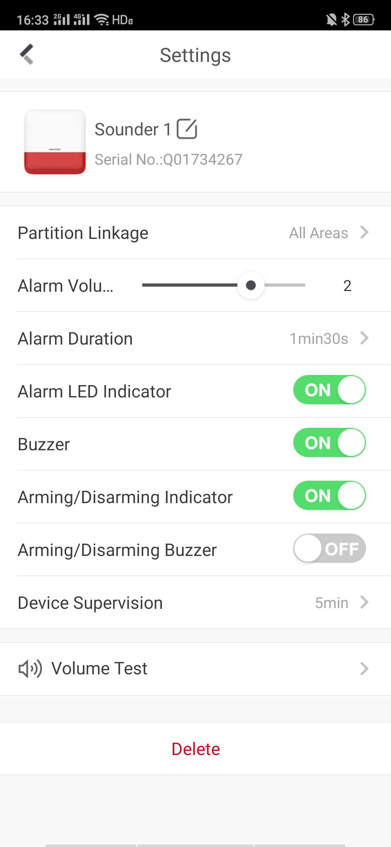
5.Adding Sounder
Press ‘+’ to add
Scan the QR code of Siren
Power up and add
Set and finish

Slide 17
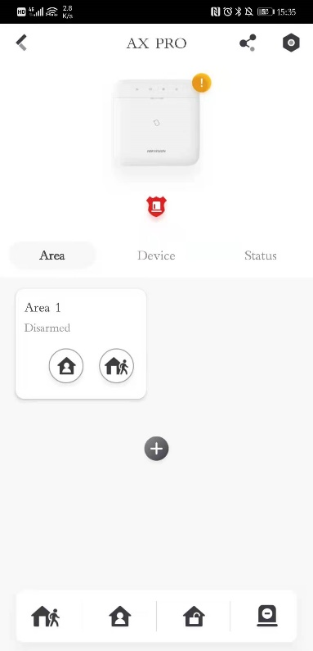
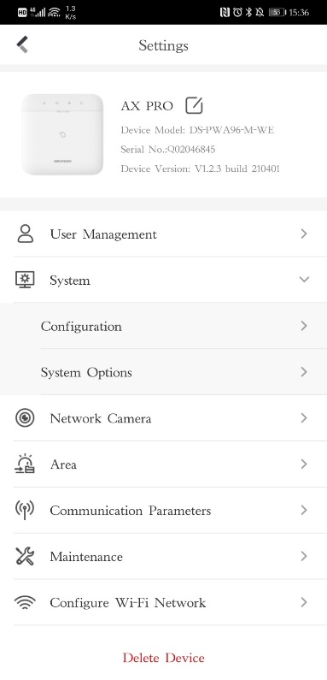
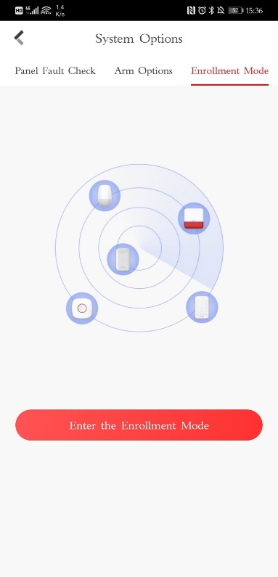
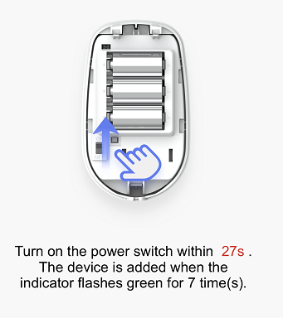
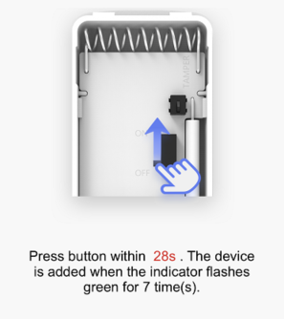
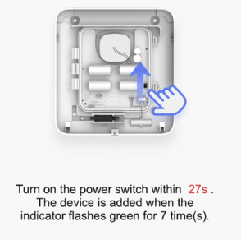
Adding other AX PRO Series detectors and accessory
Option 1. Scan the QR code on peripheral and then power the device on within 30s, the device will be added when the indicator flashes green for 7 times.
Option 2. we can also turn to “Enrollment Mode”in APP and then register multiple peripherals in group at one time.
In AX PRO system, the enrollment step will show after scanning QR code, and all the peripherals follow this enrollment logic consistently. Saving learning costs efficiently.

Slide 18
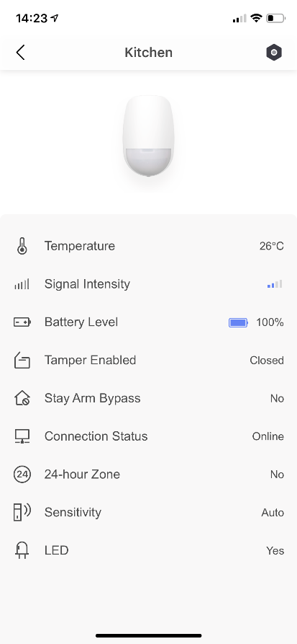
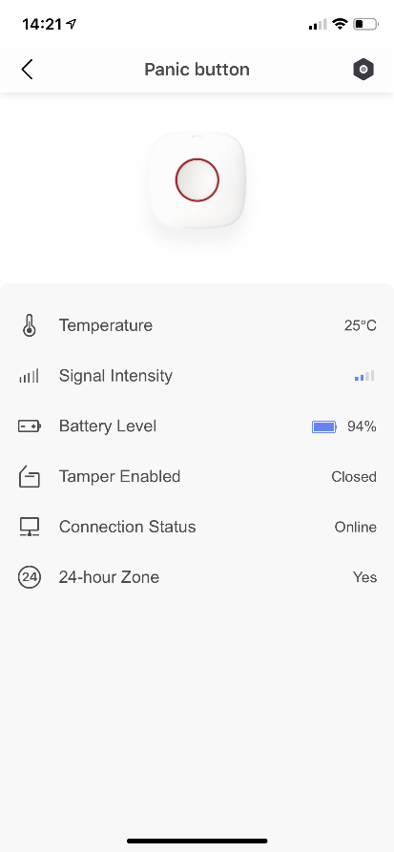
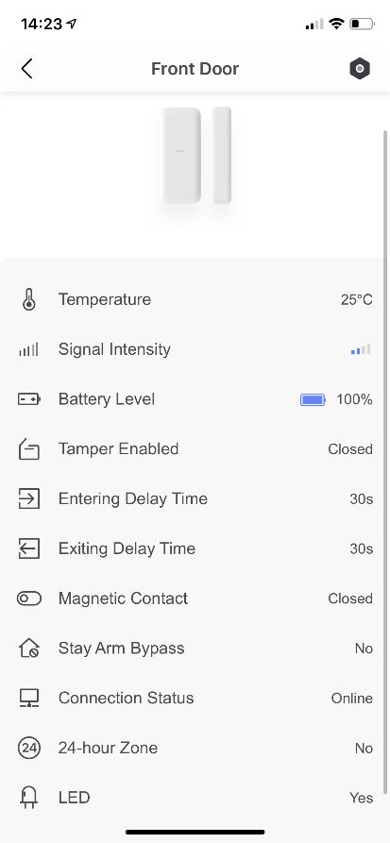
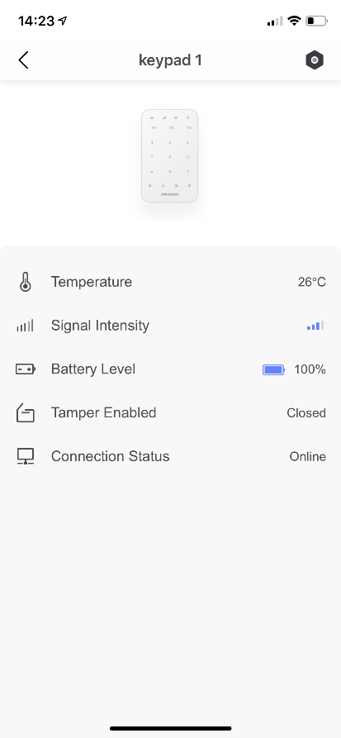
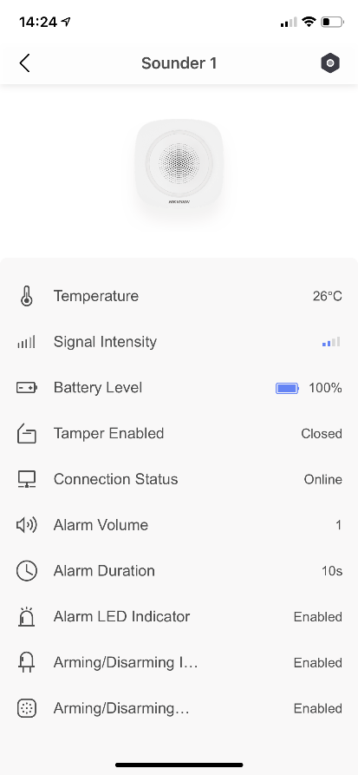
Adding AX PRO Series detectors and accessory
In AX PRO system, we can easily check more kinds of status of peripherals after adding.

Slide 19

03
Repeater
Configuration
Adding RF Repeater.
Auto-pairing features
Notes:
分类页

Slide 20




AX PRO Series RF Repeater
AX PRO Series Repeater is a radio signal ranger extender that can boost the RF communication range for AX PRO wireless alarm system.
RF Repeater

Slide 21


System Topology
Normal Detector
Accessory
RF Repeater
RF Repeater
Sounder
AX PRO
PIRCAM
Output
RF Repeater
RF Repeater

Slide 22


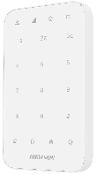




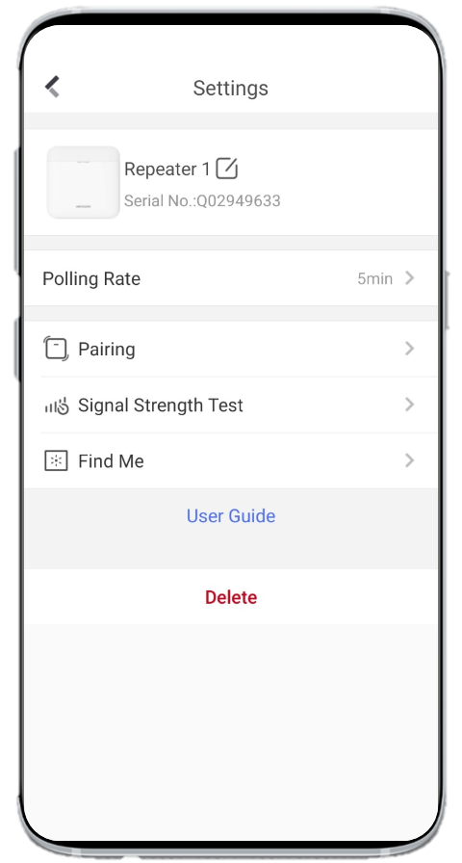


Smart Auto-pairing
After added into AX PRO system, the RF Repeater will automatically find and connect the wireless peripherals with weak RF signal, help boost their communication range.
(PIRCAM and Smoke Detector are excepted)
Strong
Middle
Weak
Offline
Repeater
AX PRO
Have to click “Pairing” manually in App or Web to boost the range of PIRCAM and Smoke Detector.

Slide 23


Repeater Setting/Status
Pairing
Click “Pairing” to boost the RF range of PIRCAM and Smoke detector.
Signal Strength Test
Click to test the Signal Strength between AX PRO Panel and Repeater
Find Me
Click “Find Me” button, and then LED indicator will blink for 30s, to help user find its location.

Slide 24



04
Relay
Configuration
Adding Relay.
Event linkage.
Notes:
分类页

Slide 25




AX PRO Home Automation
Wall Switch
1-ch high current output(90~240VAC, 13A)
Air Condition
Central Heating
Lamp
Relay Module
1-ch low current output(0~36VDC, 5A)
Electric Lock
Garage Door
Sounder
Smart Plug
1-ch high current output(100~240VAC, 10A)
Air Fans
Water Heater
Humidifier

Slide 26

Relay configuration
Linked Area
Linked with a specific Area.
Original Status
Select “Normal Closed” or “Normal Opened” for output device.
Scenario Setting
Select Linkage Solution among “by Alarm” , “by Operation”, “by Fault”, “by Schedule”, and “Manual”.
Tamper Input
Enable this features if it’s in need to detect Tamper Alarm of output device.
Polling Rate
Set heartbeat time.

Slide 27




05
Arm/Disarm
Operation
Multiple methods for arming/disarming
“Arm with fault” features
Notes:
分类页

Slide 28


(Optional) Enable/Disable “Arm with fault”
“System” > “System Options”
Enable “Arm With Fault”
And select “CheckList”

Slide 29



User configuration – Permission setting
Click “User Management”
Click Name Tag
Press the button
Set User Permission for user

Slide 30

Keypad Operation
Notes:
When “Arm With Fault” is enabled. Panel will begin to check all the items you choose in “Checklist” in arming process, and the Fault LED will blink when they system detects any fault, you can stop the arming manually, or you can press Arm Button again to arm.
When “Arm With Fault” is disabled.
(But the system will not be compliant with the European EN50131-1 standard)
When you arm the system, the panel will be armed successfully no matter the system have fault or not.

Slide 31


Keyfob Operation
Notes:
When “Arm With Fault” is enabled. Panel will begin to check all the items you choose in “Checklist” in arming process, and the Orange LED will blink when they system detects any fault, you can stop the arming manually, or you can press Arm Button again to arm.

Slide 32
06
System
Operation
SMS / Voice Call
Video Verification
Notes:
分类页

Slide 33




SMS / Voice Call Setting
Press ‘>’ to add phone numbers
Press to continue
Add and configure
Add and configure

Slide 34


SMS / Voice Call Features
Notification SMS
Voice Call

Slide 35




Video Verification
1.Adding IP Camera
Press ‘>’ to add camera
Press to add
Input parameters and save
Refresh and finish

Slide 36




Video Verification
1.Zone Linkage
Select one detector you want to link
Press to configure
Press ‘>’ to link
Select one camera and finish

Slide 37

Video Verification
Feature demonstration

Slide 38
THANK YOU
International Product and Solution Center
Notes:
封底
产品图可更换，配图无需更换

