Slide 1
Auxiliary Care Radar Introduction and Configuration

Slide 2

01
Radar Configuration Overview
02
Auxiliary Care Radar
CONTENTS
03
Radar Network Configuration
04
Radar Firmware Upgrade
05
Platform Configuration and Application

Slide 3


P.01
Radar Configuration Overview

Slide 4


Radar Configuration Process
To use the Auxiliary Care radar , please follow the steps below:
Configuration Process
Install the radar on the wall and power up
Check/Update Wifi/Radar firmware version via RadarPC tool
Use the RadarPC tool to configure the network
Add Radar to the HCP platform

Slide 5
01
Software Preparation
Software version: Please check ftp or One cloud disk for latest version
Program | Version
Vital signs detection tool | 3.x.x
Radar Firmware | 3.x.x
WIFI Firmware | 3.x.x
HikCentral Pro | 2.1.1_20211229
Download link:
https://one.hikvision.com/#/link/JBg6XFaqaW9wCP2FjvDc Password：sudJ
FTP path:
ftp://hikftp.hikvision.com:400/Product File(Overseas)/00 Oversea Products/04 Mobile & Traffic//04 Firmware& Software/02 Traffic/

Slide 6
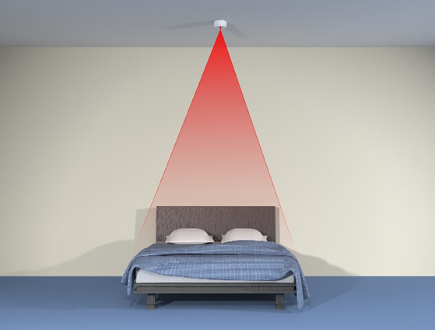
P.02
Auxiliary Care Radar

Slide 7


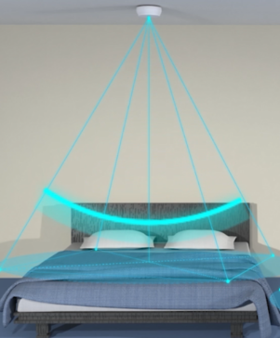
Product Introduction
Introduction
The Auxiliary Care radar can realize the monitoring of vital signs such as manned, unmanned, breathing, and heartbeat.
Radar can be applied to the top of the bedroom bed. Non-contact coverage of the range of the bed. Obtain the human body‘s bed time, time out of bed, breathing frequency, heartbeat frequency, body movement times and other information. So as to assist the human body’s sleep quality and health status analyze.
Information
No privacy concerns
Remote non-contact detection
Real-time output of human breathing and heartbeat frequency
It can output the information of whether the human body is in bed, and count the time in bed/out of bed
It can output information about whether the human body moves, and count the number of body movements
Small size, beautiful structure, convenient installation

Slide 8
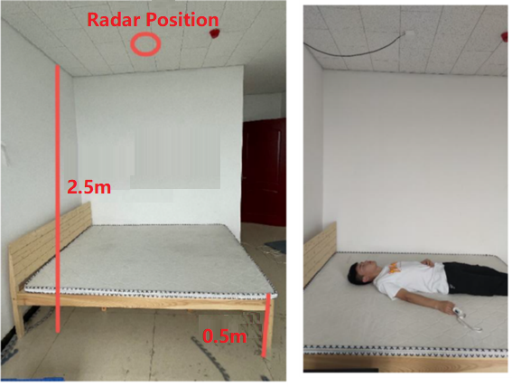
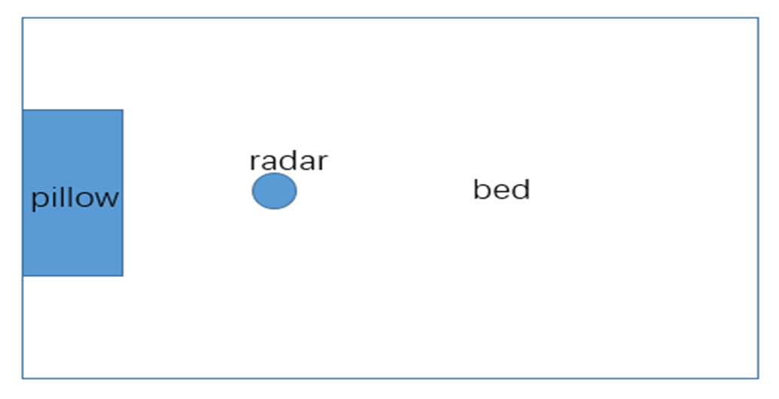
01
Vital Sign Radar Installation
Select an appropriate position 1.5-2.5 meters high on the wall. Use tools to fix the radar on the ceiling or beam.
The rear of the radar panel is close to the ceiling or beam. Make sure that the radar panel is facing the surface of the bed.
The radar is aimed at the position of the chest cavity.
The arrow on the front shell of the radar faces the direction of the foot of the bed.
The effective monitoring range is a bed with a maximum of 2m*2m
Note : When wiring, stick to the wall, and the power cord should not appear in the radar field of view.
Top view

Slide 9
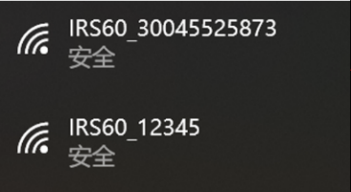
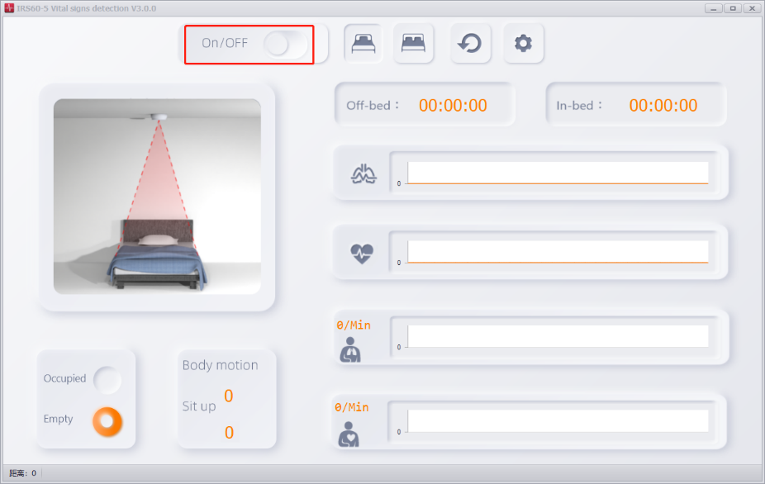
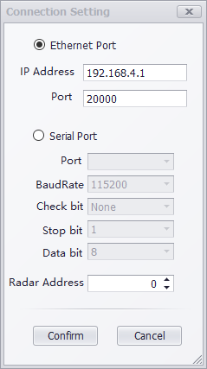
01
RadarPC: IRS60-5 Vital signs detection tool
RadarPC is a tool that can connect to radar, receive and view data from radar, upgrade firmware and configure radar network.
Radar Connection Steps:
First, power on Radar, make sure your computer is connected to Radar hotspot (name : IRS60_serial number, password : abcd1234)
Click On/OFF to connect/disconnect to radar.
Enter IP 192.168.4.1 (when hotspot connected), Port: 20000, then click Confirm.
(You can also enter specific Radar IP here to connect after Radar Network Configuration is done, and your computer must connected to Wi-Fi)

Slide 10
P.03
Radar Firmware Upgrade

Slide 11

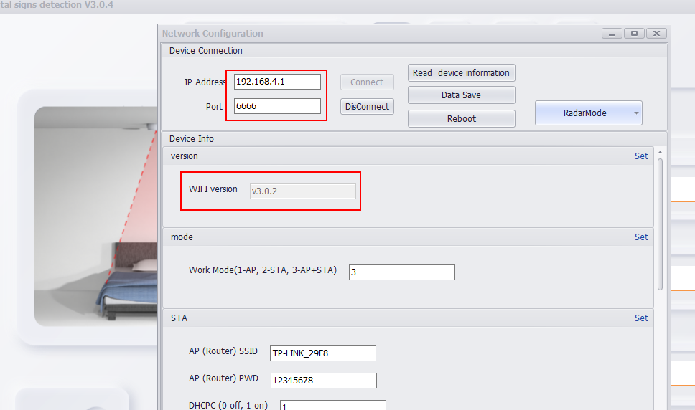
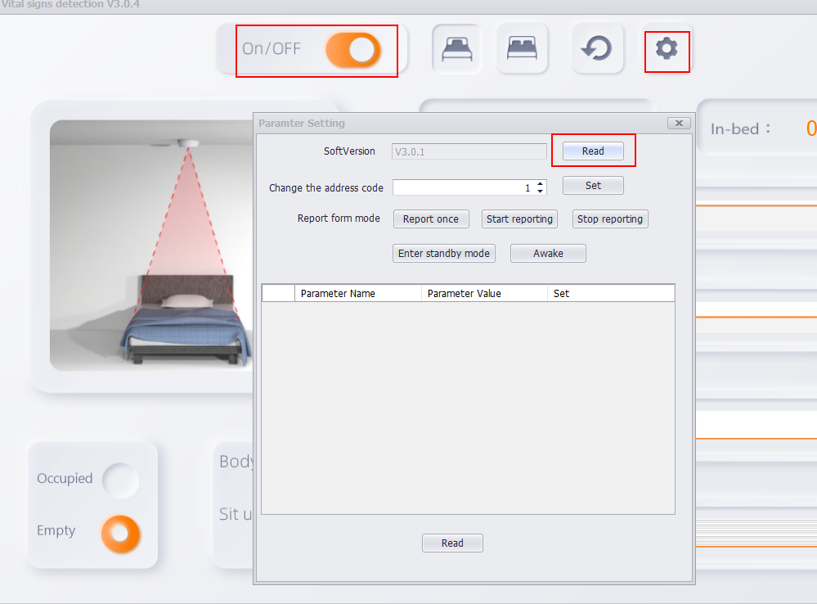
01
Check firmware version
Check WiFi firmware version：
Open RadarPC tool, press F2 on keyboard, enter ip and port, press connect.
Check Radar firmware version：
After connecting Radar to the tool, press , click Read.
Note：If the firmware of WiFi and radar is not the latest version, please upgrade the firmware

Slide 12
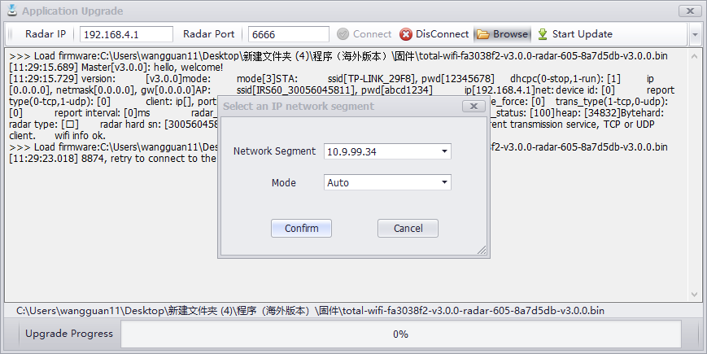
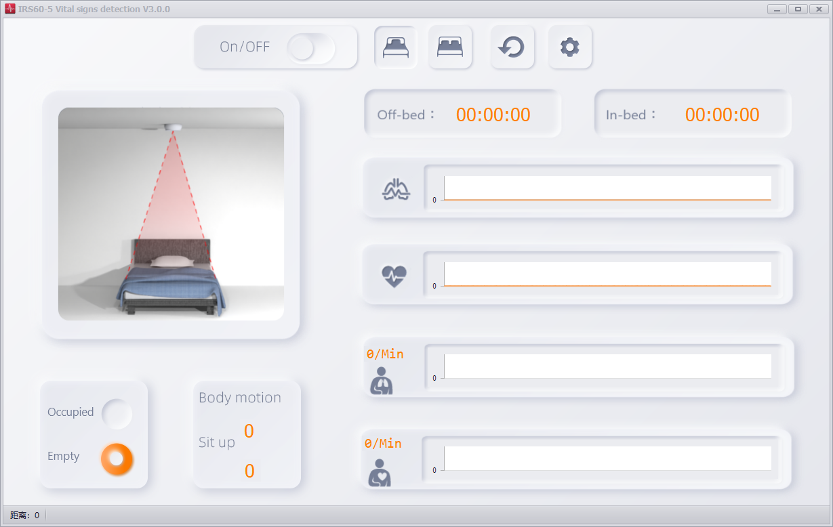
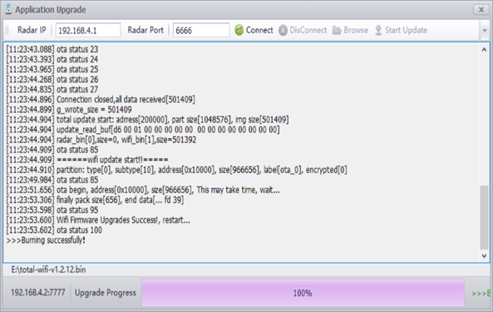
01
Vital Signs Detection Radar Firmware Upgrade
Upgrade Steps:
1 Open IRS60-5 Vital signs detection tool, click F1 on keyboard
2 Enter IP 192.168.4.1 (when hotspot connected)
or Radar IP (when Wifi connected and Radar IP configured)
3 Enter Port 6666
4 Click Connect Button
5 Click Browse, Select file to be upgraded
6 Choose Network Segment and Mode
7 Click Start Upgrade
2
3
4
5
7
6
Select the same network segment as Radar
Choose AUTO
Must be OFF
1. Keyboard Input F1

Slide 13
P.04
Radar Network Configuration

Slide 14
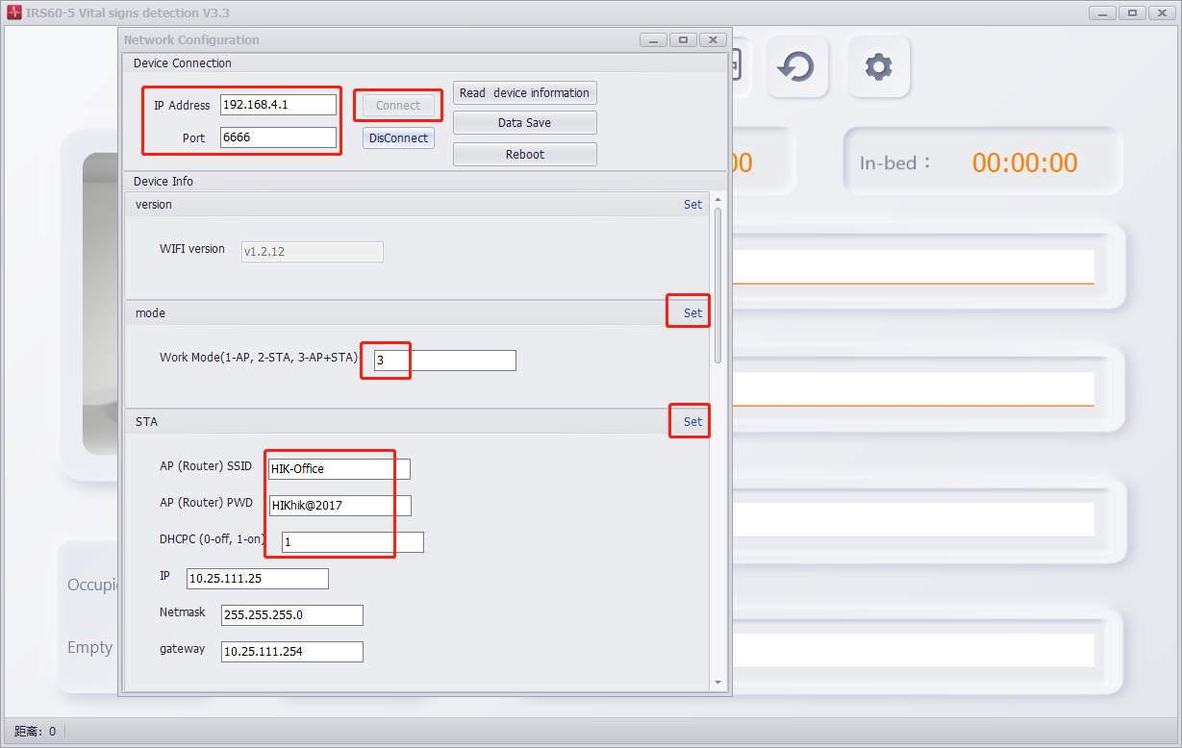
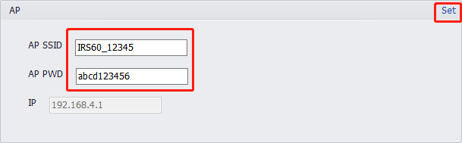
01
Radar Network Configuration
Step1 Computer Connected to Radar Hotspot
2
1
Step2 Open IRS60-5 Vital signs detection tool and press F2 on the keyboard.
4
Step3 Connect to radar and set parameters
- Radar Hotspot IP Address : 192.168.4.1
- Port : 6666
- Work Mode : 3
- [STA] AP(Router)SSID : Wi-Fi name
AP(Router)PWD : Wi-Fi password
DHCP : 0 (off)
Manually set IP, Netmask and gateway
- [AP] AP SSID: Hotspot name
AP PWD: Hotspot password
3
6
5
0
7
8

Slide 15
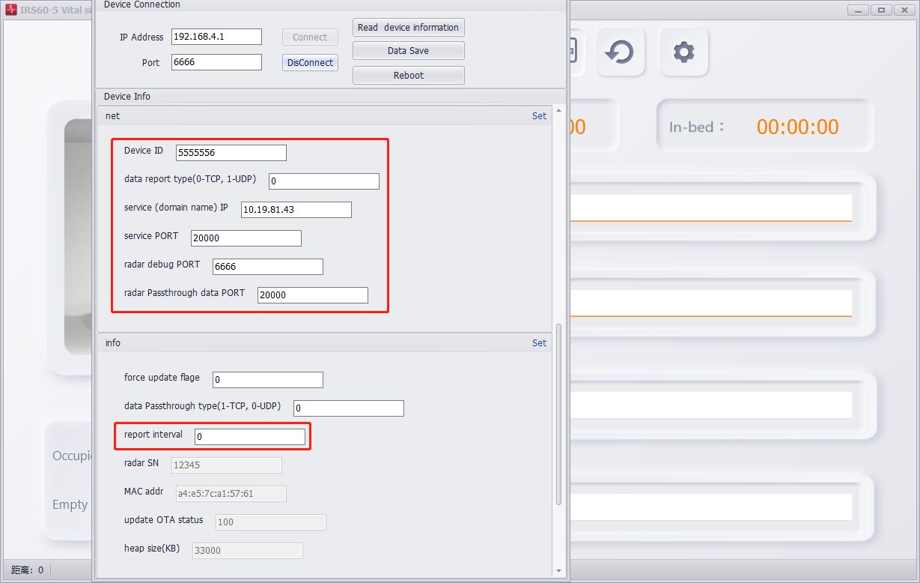
01
Radar Network Configuration
- [net] Device ID : Range is 1-999999999
data report type : 0
service IP : HCP Platform Server IP
service PORT : 20000
radar debug PORT: 6666
radar Passthrough data PORT: 20000
- [info] report interval: 0 (50ms)
13
14
9
10
12
Note: Click Set after modifying the parameters.
After setting, click Data Save, then Reboot.
11

Slide 16
P.05
HCP Platform Configuration and Application

Slide 17
01
Overview
Add device
Remote configuration
Real-time monitoring
History Search
Event and Alarm

Slide 18
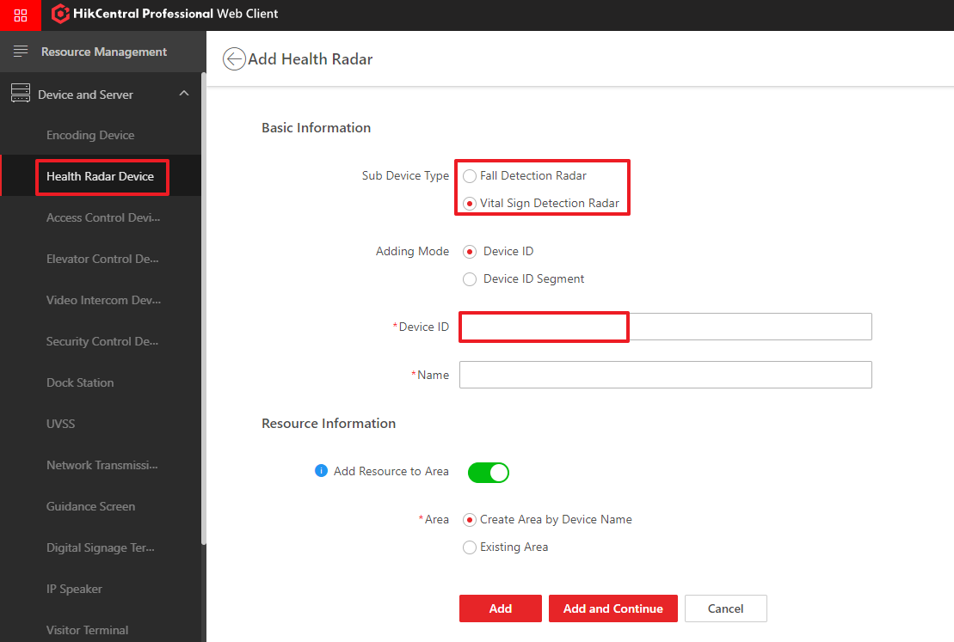
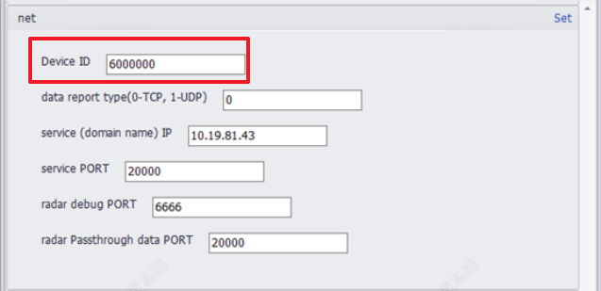
01
Add Health Radar Device
Go to General→ Resource Management add the device. The devices include Fall Detection Radar, Auxiliary Care Radar.

Slide 19
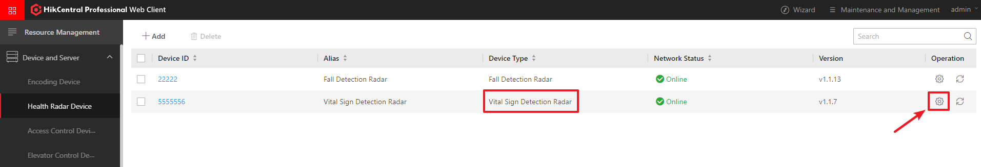
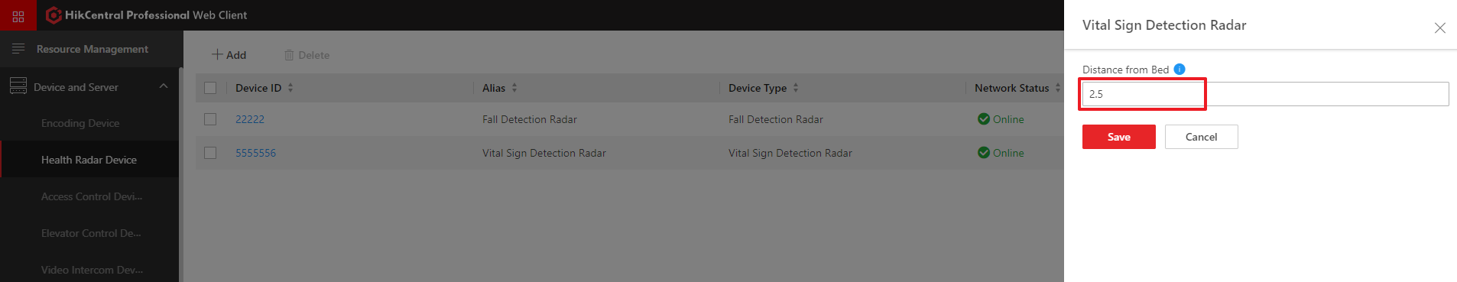
01
Auxiliary Care Radar Configuration
To remotely configure the Auxiliary Care Radar, click the configuration button, you can obtain and modify the Distance from Bed (m).
Configuration button
Note: 1. Only online radar devices support remote configuration
2. The Distance from Bed is floating point data, value is actual data, unit is meter

Slide 20
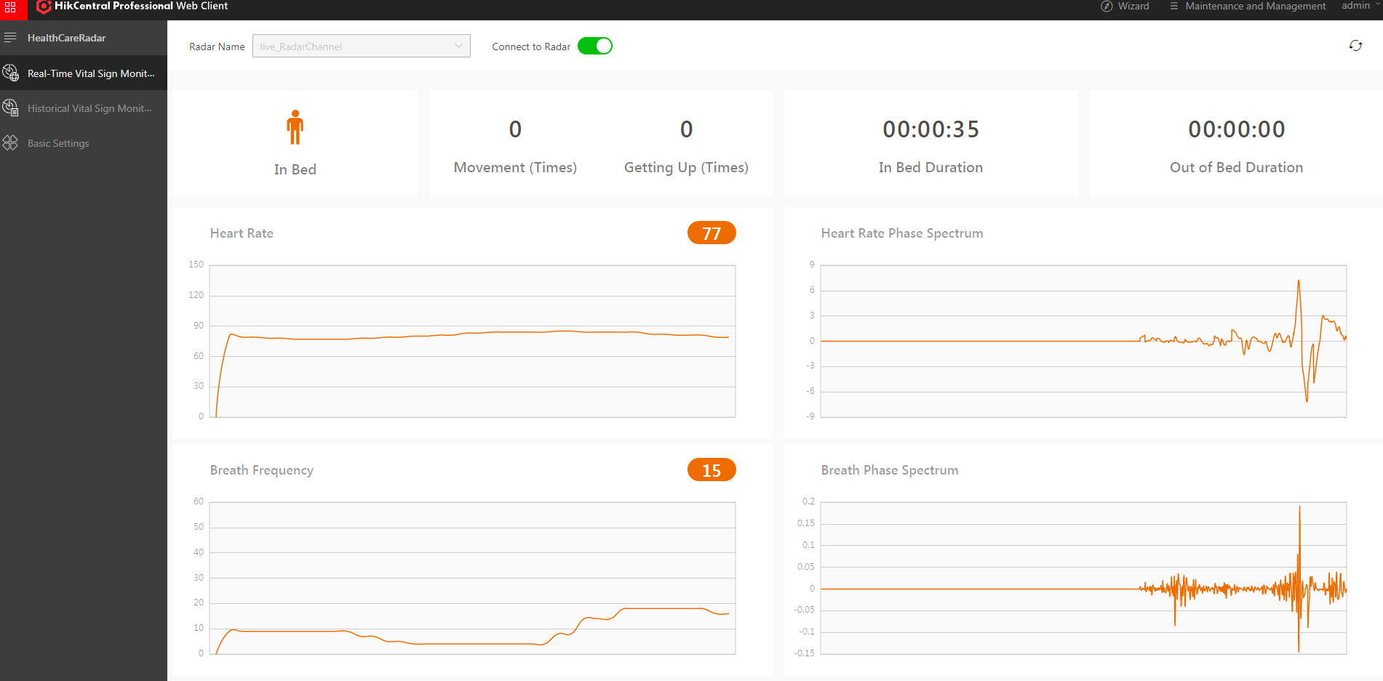
01
Real-Time Vital Sign Monitoring
Go to Health Radar→ Real-Time Monitoring, Select the Vital Sign Radar Channel and click Connect to Radar. Start receiving real-time data reported by the physical sign radar, including respiration, heartbeat frequency, phase, and people/nobody/body movement/rise events, etc.
Note: 1. A web interface can only open real-time monitoring of one Vital Sign Radar at a time
2. The interface is refreshed and the data is cleared

Slide 21
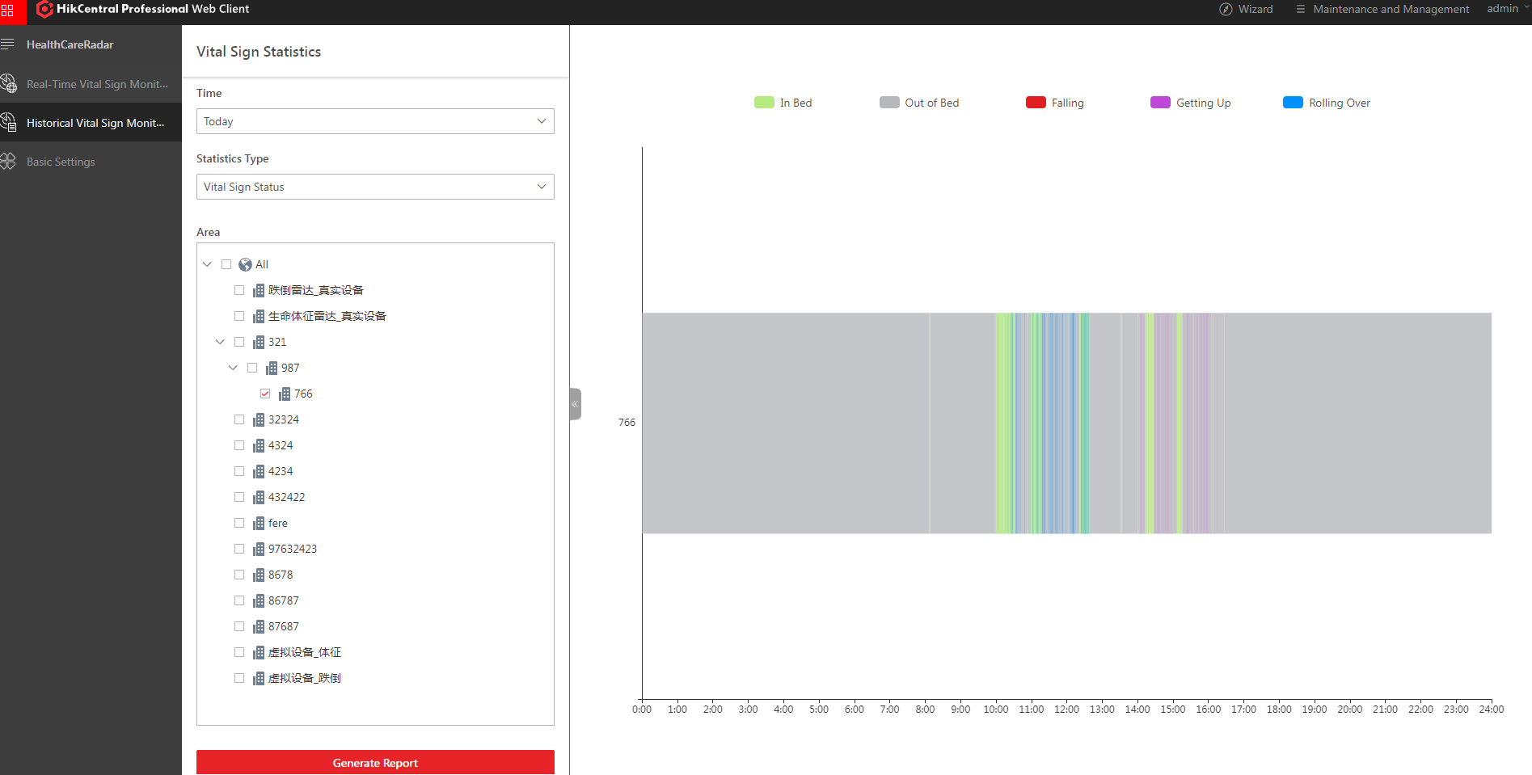
01
Historycal Vital Sign Monitoring
Go to Health Radar→ History Search, Select Vital Sign Status , you can view the distribution of Vital Sign Status data for any day.
Note: 1. Select up to 10 Areas
2. Support mouse wheel to zoom in and view

Slide 22
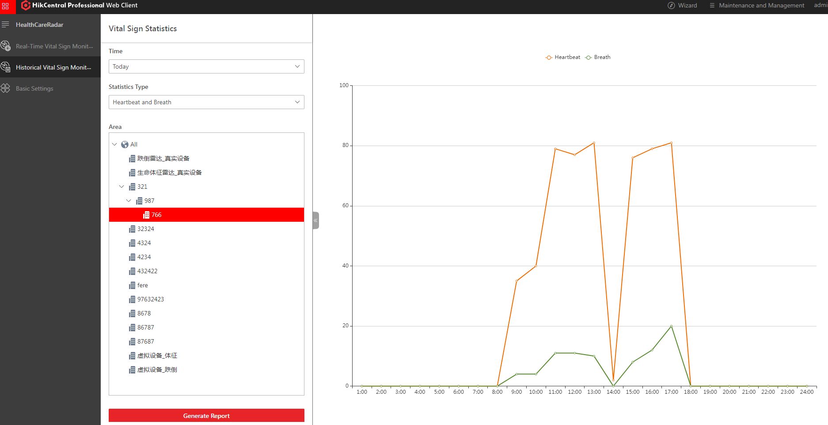
01
Historycal Vital Sign Monitoring
Go to Health Radar→ History Search, Select Heartbeat and Breath , you can view the distribution of Heartbeat and Breath data average per hour on any day.

Slide 23
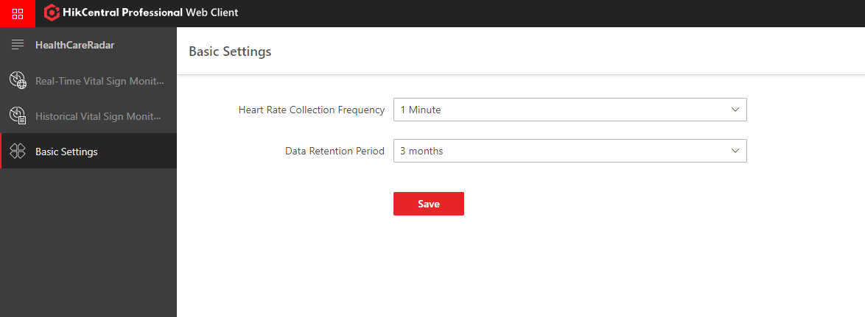
01
Basic Settings
Go to Health Radar→ Basic Settings, You can configure the Heart Rate Collection Frequency of Auxiliary Care Radar and Data Retention Period of radar events.

Slide 24
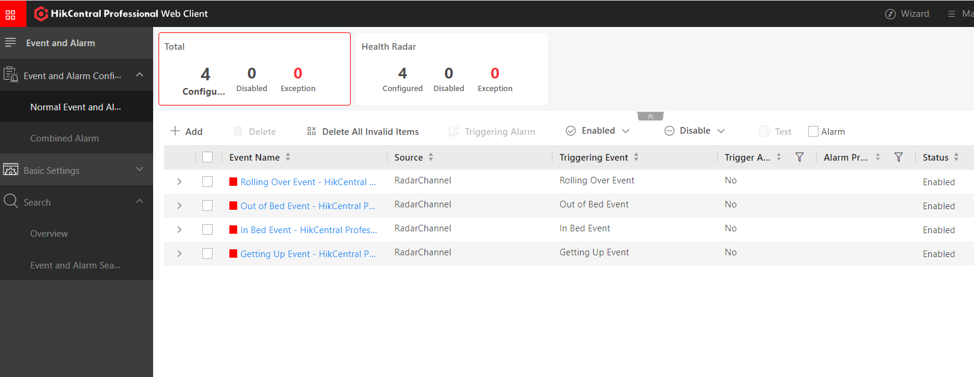
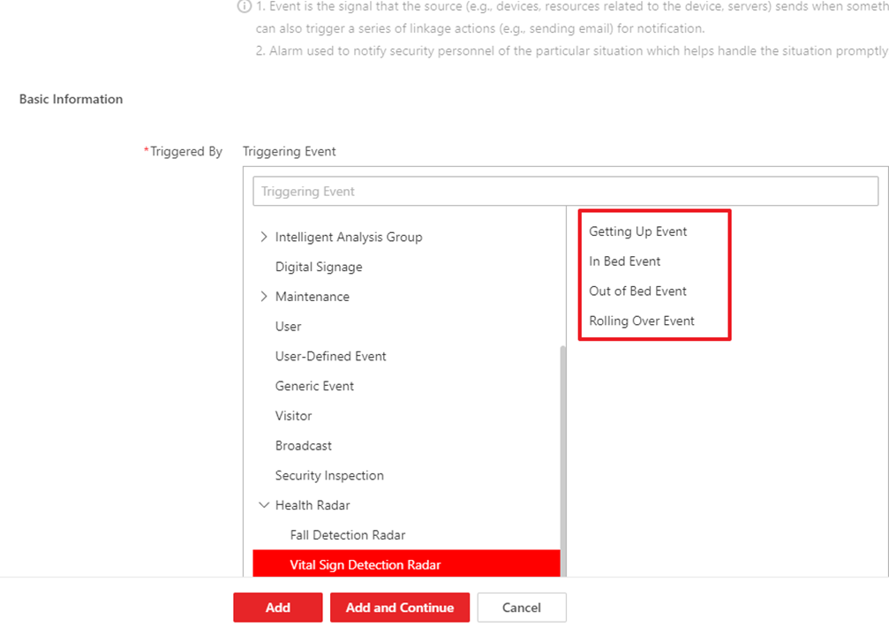
01
Event and Alarm
Go to General→ Event and Alarm add the Health Radar alarm. The alarm include Getting Up Event, In Bed Event, Out of Bed Event, Rolling Over Event.

Slide 25
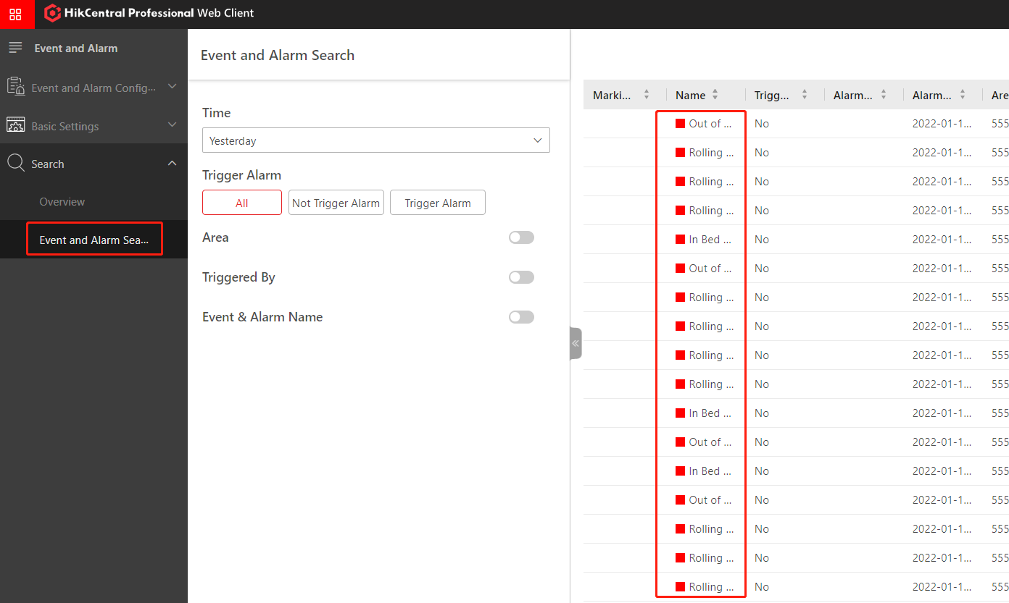
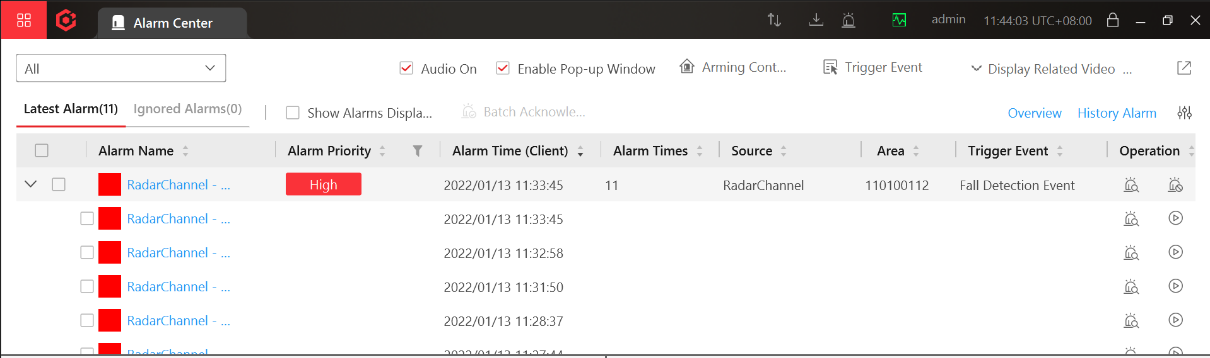
01
Event and Alarm
Search event and alarm:
Alarm information displayed on the control client

Slide 26

THANK YOU
For Watching
HikCentral Professional - HealthCare

