Slide 1
PSM 2.0
RADAR HANDS-ON
HIKVISION EUROPE | All Rights Reserved.

Slide 2
Radar
HikCentral is compatible with Hikvision radar device (60m & 120m), which can help to manage key security area and response to emergency case.
Add radar device*¹
Add Map and relate PTZ camera
Draw zone and Calibrate PTZ camera
Configure Event/Alarm
Check live track on the map
Check alarm info & history track
Manually arm/disarm(optional)
Physical View
Logical View
Logical View
Event & Alarm
Monitoring
Alarm Center
Arming Control
*¹ For radar device, the port no. is 80.

Slide 3
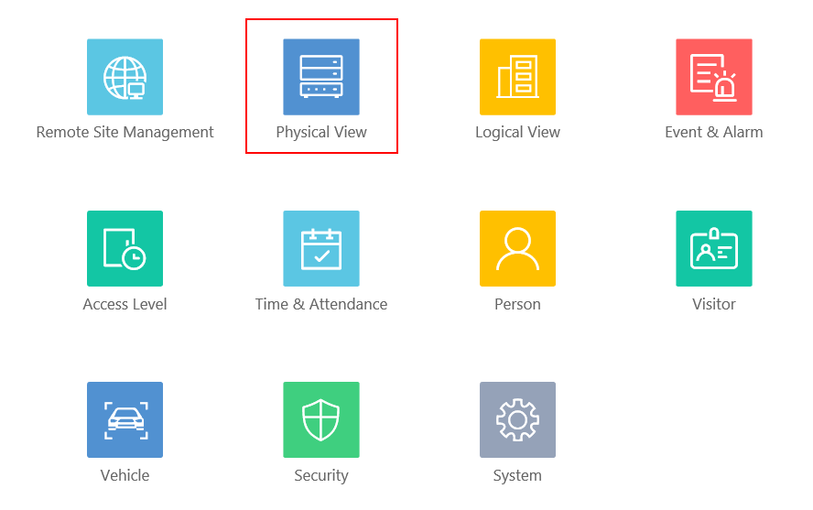
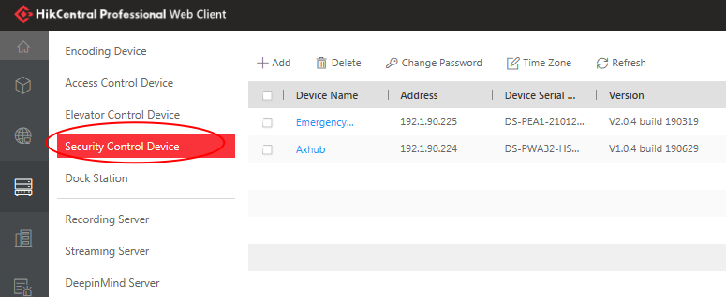
Radar
1. Add Radar Device
2. Add Map and relate PTZ camera
3. Draw Zone and Calibrate PTZ camera
4. Configure Event/Alarm
5. Check Live Track on the Map
6. Check Alarm Info & History Track
7. Manually Arm/Disarm(Optional)
Web Client - Go to Physical view – Access control device

Slide 4
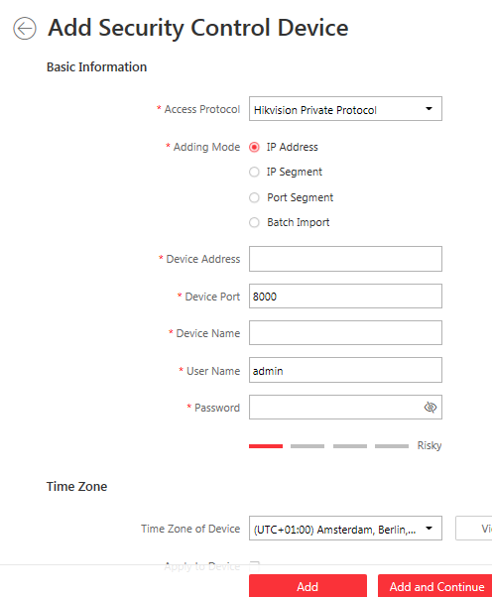
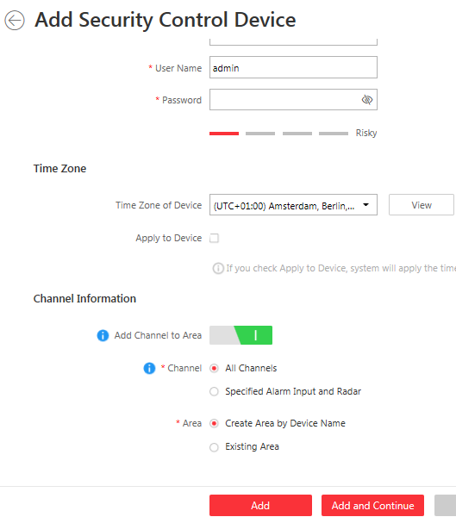
Radar
1. Add Radar Device
Remember the device port should be 80
2. Add Map and relate PTZ camera
3. Draw Zone and Calibrate PTZ camera
4. Configure Event/Alarm
5. Check Live Track on the Map
6. Check Alarm Info & History Track
7. Manually Arm/Disarm(Optional)
Click add – Input basic information – choose all channels or specific alarm input and radar to new area or existing area
Notes:
For Radar product， HikCentral only supports 1 radar resource，no alarm input，and 4 outputs.

Slide 5
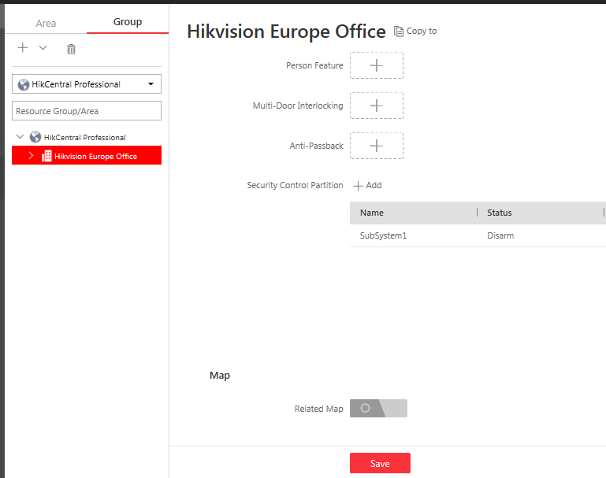
Radar
1. Add Radar Device
2. Add Map and relate PTZ camera
3. Draw Zone and Calibrate PTZ camera
4. Configure Event/Alarm
5. Check Live Track on the Map
6. Check Alarm Info & History Track
7. Manually Arm/Disarm(Optional)
Go to Logical view –Group – choose a area – enable Related Map

Slide 6
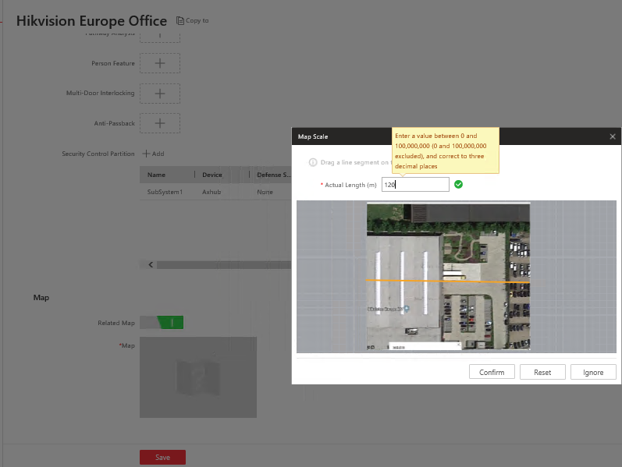
Radar
Map adding
1. Add Radar Device
Actual length
2. Add Map and relate PTZ camera
3. Draw Zone and Calibrate PTZ camera
4. Configure Event/Alarm
A reference line
5. Check Live Track on the Map
6. Check Alarm Info & History Track
7. Manually Arm/Disarm(Optional)
Method 1: upload a picture- draw a line – input the actual length, the map scale will be updated by this data.
Notes:
Please remember to set the correct map scale, otherwise, the radar icon and map can not matched.

Slide 7
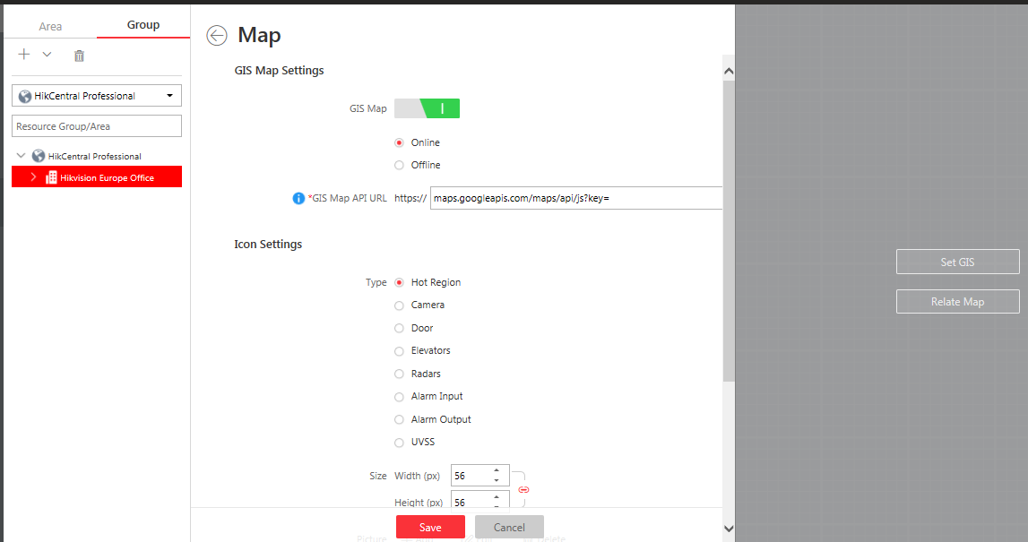
Radar
GIS Map setting
1. Add Radar Device
2. Add Map and relate PTZ camera
3. Draw Zone and Calibrate PTZ camera
4. Configure Event/Alarm
5. Check Live Track on the Map
6. Check Alarm Info & History Track
7. Manually Arm/Disarm(Optional)
Method 2: Set GIS- input GIS Map API URL
Notes:
Currently, the GIS Map is not recommended, because radar detection area is not clear when located in the map.
To get the API key, please go to https://developers.google.com/map/documentation/javascript/get-api-key.To ensure the proper usage, please activate it.

Slide 8
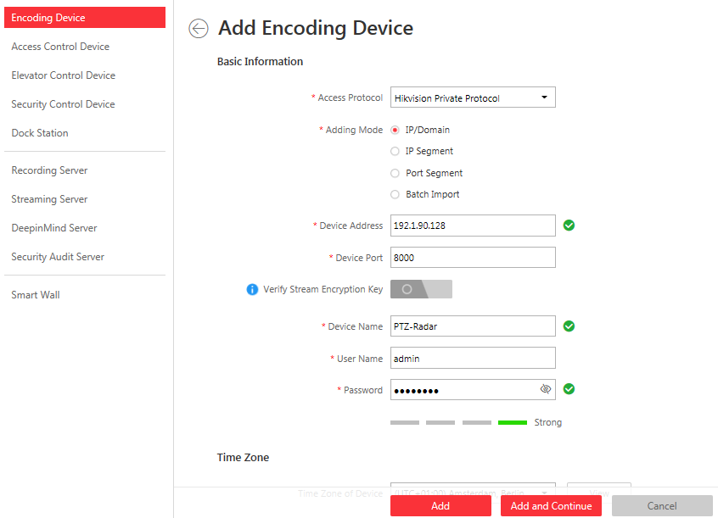
Radar
PTZ camera adding
1. Add Radar Device
2. Add Map and relate PTZ camera
3. Draw Zone and Calibrate PTZ camera
4. Configure Event/Alarm
5. Check Live Track on the Map
6. Check Alarm Info & History Track
7. Manually Arm/Disarm(Optional)
Web Client - Go to Physical view – encoding device，
Click add – Input basic information – choose all channels to new area or existing area

Slide 9
Radar
Set PTZ Camera Initial Position
Before calibration between radar and PTZ, we have to set the initial position of PTZ camera first, because sometimes the camera will be installed a little bit down.
Select a reference object about 50m away from the speed dome, and select a point (on the reference object) whose altitude is the same as the speed dome’s.
1. Add Radar Device
2. Add Map and relate PTZ camera
3. Draw Zone and Calibrate PTZ camera
4. Configure Event/Alarm
50m
5. Check Live Track on the Map
6. Check Alarm Info & History Track
Same height as PTZ Dome Camera
7. Manually Arm/Disarm(Optional)
Put the target in the middle

Slide 10
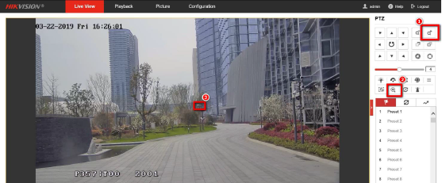
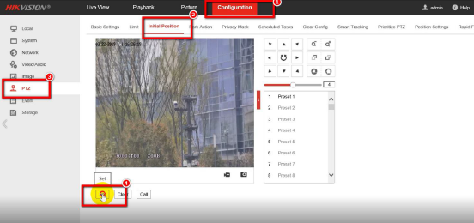
Radar
Set PTZ Camera Initial Position
1. Add Radar Device
Enter the IP address of the speed dome in the web browser to enter the web client. Adjust the PTZ in the Live View page to make the point displayed in the frame.
Enter the Configuration → PTZ → Initial Position page, and click Set to set the initial position.
2. Add Map and relate PTZ camera
3. Draw Zone and Calibrate PTZ camera
4. Configure Event/Alarm
5. Check Live Track on the Map
6. Check Alarm Info & History Track
7. Manually Arm/Disarm(Optional)

Slide 11
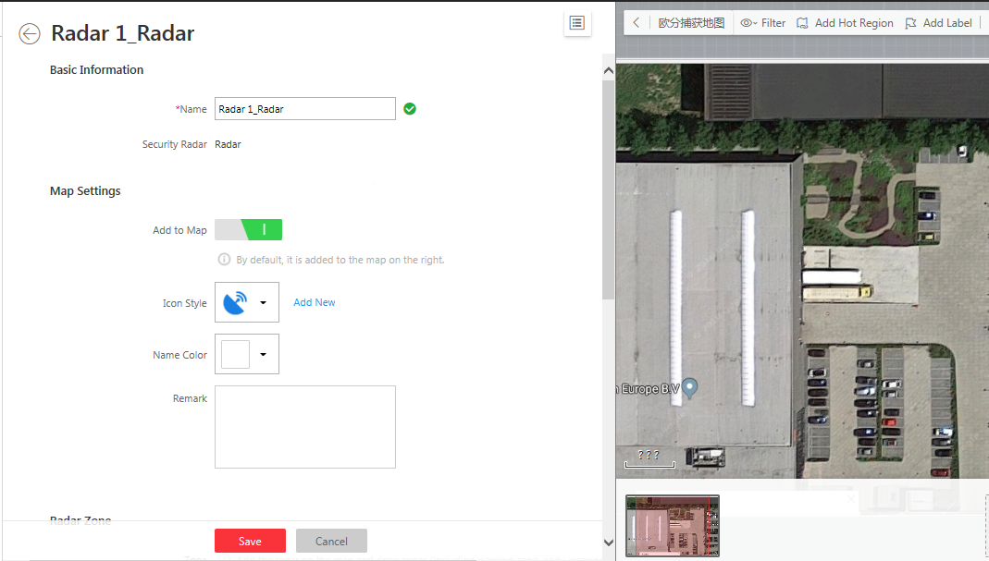
Radar
Add radar to map
1. Add Radar Device
2. Add Map and relate PTZ camera
3. Draw Zone and Calibrate PTZ camera
4. Configure Event/Alarm
5. Check Live Track on the Map
6. Check Alarm Info & History Track
7. Manually Arm/Disarm(Optional)
Go to logical view–Radars, enter radar setting, add the radar to the map

Slide 12
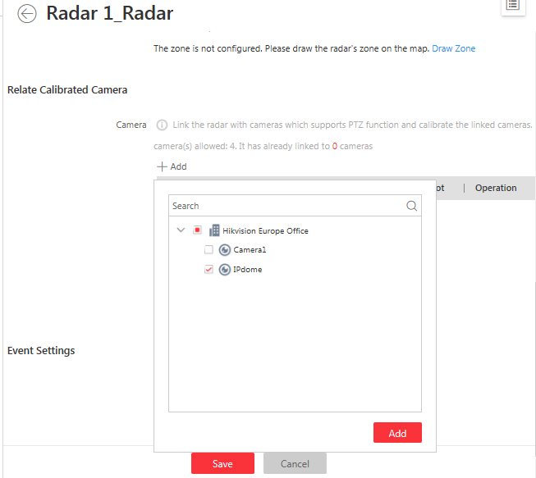
Radar
Add PTZ camera to radar
1. Add Radar Device
2. Add Map and relate PTZ camera
3. Draw Zone and Calibrate PTZ camera
4. Configure Event/Alarm
5. Check Live Track on the Map
6. Check Alarm Info & History Track
7. Manually Arm/Disarm(Optional)
Go to logical view–Radars, enter radar setting, relate the PTZ camera

Slide 13
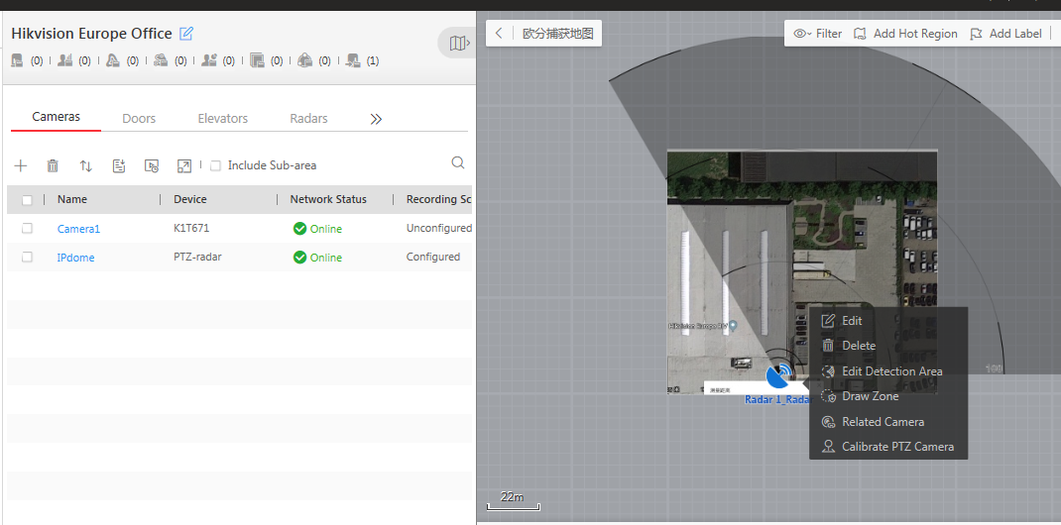
Radar
Settings of Radar
1. Add Radar Device
2. Add Map and relate PTZ camera
3. Draw Zone and Calibrate PTZ camera
4. Configure Event/Alarm
5. Check Live Track on the Map
Left click the radar icon
6. Check Alarm Info & History Track
7. Manually Arm/Disarm(Optional)
Go to logical view– Radar is already added.
Notes:
You can drag the radar to the actual position, adjust the angle of radar.
Edit detection area: adjust the angle of radar.

Slide 14
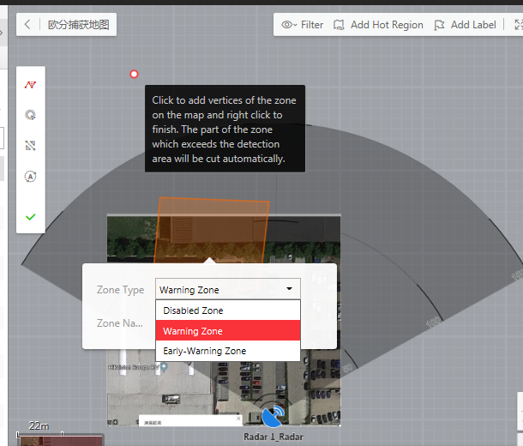
Radar
Zone drawing
Manually draw
Zone segmentation
1. Add Radar Device
Distance segmentation
2. Add Map and relate PTZ camera
Field assistance
Finish
3. Draw Zone and Calibrate PTZ camera
4. Configure Event/Alarm
5. Check Live Track on the Map
6. Check Alarm Info & History Track
7. Manually Arm/Disarm(Optional)
Go to logical view– left click the radar – draw zone.
Notes:
Manually Draw
You can draw any shape for the zone using this method.
Zone Segmentation
Split a zone into two smaller zone by a line.
Distance Segmentation
Split a zone into two smaller zone by an arc.
Field Assistance
Click to enable zone painting assistance function. For example, person A takes an on-site
walk along the field to shape a closed figure as a zone. And then the moving path will
automatically be painted as a zone on the map and a window for selecting zone type will
pop up. And then Person B which operating the computer running the Web Client select a
type for the zone.

Slide 15
Radar
Zone Type
Early Warning Zone
Detecting targets
Trigger an event
Alarm linkage
Video pop-up
Video recording and playback
Trail display
Trail recording
1. Add Radar Device
2. Add Map and relate PTZ camera
Warning Zone
Detecting targets
Trigger an event
Alarm linkage
Video pop-up
Video recording and playback
Trail display
Trail recording
3. Draw Zone and Calibrate PTZ camera
4. Configure Event/Alarm
5. Check Live Track on the Map
6. Check Alarm Info & History Track
Disabled Zone
Do nothing when target detected
Mainly used for areas with too many moving targets
7. Manually Arm/Disarm(Optional)

Slide 16
Radar
Calibrate PTZ camera
1. Add Radar Device
2. Add Map and relate PTZ camera
3. Draw Zone and Calibrate PTZ camera
4. Configure Event/Alarm
5. Check Live Track on the Map
6. Check Alarm Info & History Track
7. Manually Arm/Disarm(Optional)
Go to logical view– left click the radar – Calibrate PTZ camera.
Notes:
要求浏览器的分辨率为默认的分辨率，按下CTRL+0能够恢复默认的100%分辨率
1.Target person should better take up vertically 2/3 of the linked camera’s real-time scene. In addition, in the horizontal direction, you’d better put the figure of target person in the middle of the image.
2.If the radar and PTZ camera are installed in the same pole, 1 calibration point is enough. If they are installed separately, need at least 4 points.

Slide 17
Radar
Track Setting
1. Add Radar Device
2. Add Map and relate PTZ camera
3. Draw Zone and Calibrate PTZ camera
4. Configure Event/Alarm
5. Check Live Track on the Map
6. Check Alarm Info & History Track
7. Manually Arm/Disarm(Optional)
Normally, if you calibrate successfully, PTZ camera will automatically track the intruder, if not, please check the setting in radar web page, camera should be linked with specified zones.

Slide 18
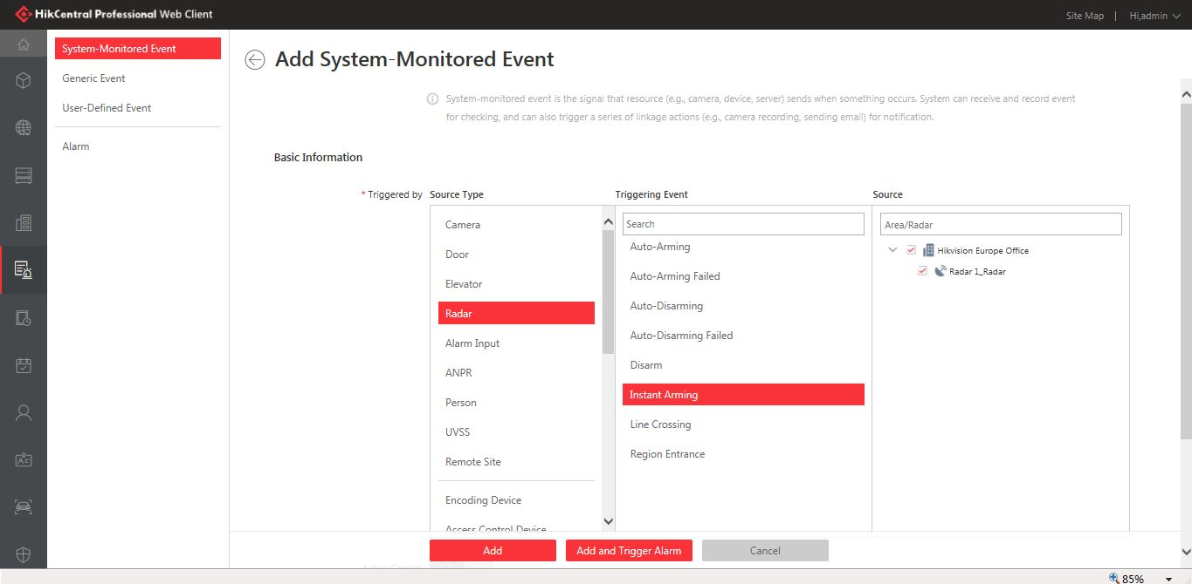
Radar
System-monitored event
1. Add Radar Device
2. Add Map and relate PTZ camera
3. Draw Zone and Calibrate PTZ camera
4. Configure Event/Alarm
5. Check Live Track on the Map
6. Check Alarm Info & History Track
7. Manually Arm/Disarm(Optional)
Configure Event for radar – choose triggering event and source then enable linkage actions
Notes:
Auto-Arming/ Auto-Arming failed/ Auto disarming /Auto- Disarming failed/ Disarm / Instant Arming /Line Crossing(don’t support configuration in Hikcentral but can receive the event) /Region Entrance
System-monitored event is the signal that resource (e.g., device, camera, server) sends when
something occurs. System can receive and record event for checking, and can also trigger a series
of linkage actions for notification. The event can also trigger an alarm for further notification and
linkage actions (such as alarm recipients, pop-up window on the Control Client, displaying on the
Smart Wall, etc.). You can check the event related video and captured pictures via the Control
Client if you set the recording and capturing as event linkage.

Slide 19
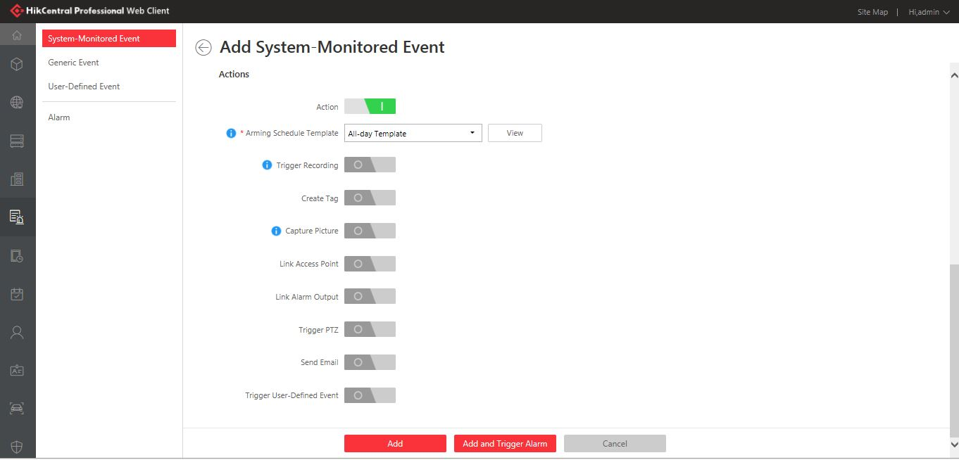
Radar
System-monitored event
1. Add Radar Device
2. Add Map and relate PTZ camera
3. Draw Zone and Calibrate PTZ camera
4. Configure Event/Alarm
5. Check Live Track on the Map
6. Check Alarm Info & History Track
7. Manually Arm/Disarm(Optional)
Configure Event for radar – choose triggering event and source then enable linkage actions
Notes:
Active Control：
Active Control is used to avoid the same event occurs frequently in a short time, which may
aggravate the burden of HikCentral Professional event center. You need to set the Threshold
for Reactivation. For example, you have set the Threshold for Reactivation as 30 s, the same
events from the same camera within 30 s will be regarded as one event on the HikCentral
Professional.
• The Threshold for Reactivation is 15 s by default. You can set it from 15 s to 1800 s.
Trigger record：These cameras will be triggered for recording and you can view the video files when checking event.
Trigger up to 64 PTZs.

Slide 20
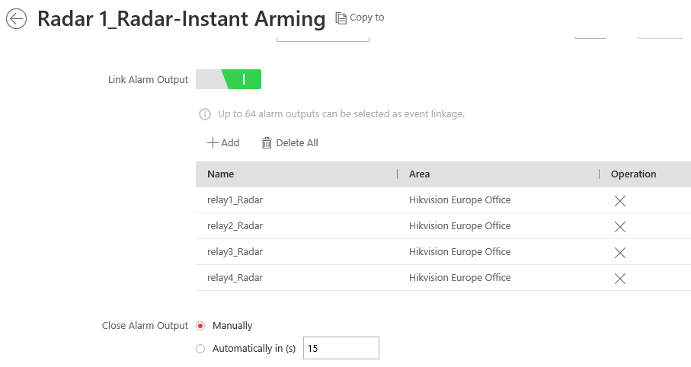
Radar
System-monitored event
1. Add Radar Device
2. Add Map and relate PTZ camera
3. Draw Zone and Calibrate PTZ camera
4. Configure Event/Alarm
5. Check Live Track on the Map
6. Check Alarm Info & History Track
7. Manually Arm/Disarm(Optional)
Enable Link alarm output– set action of alarm output when event happens (often used for wired siren, strobe lights, etc.)

Slide 21
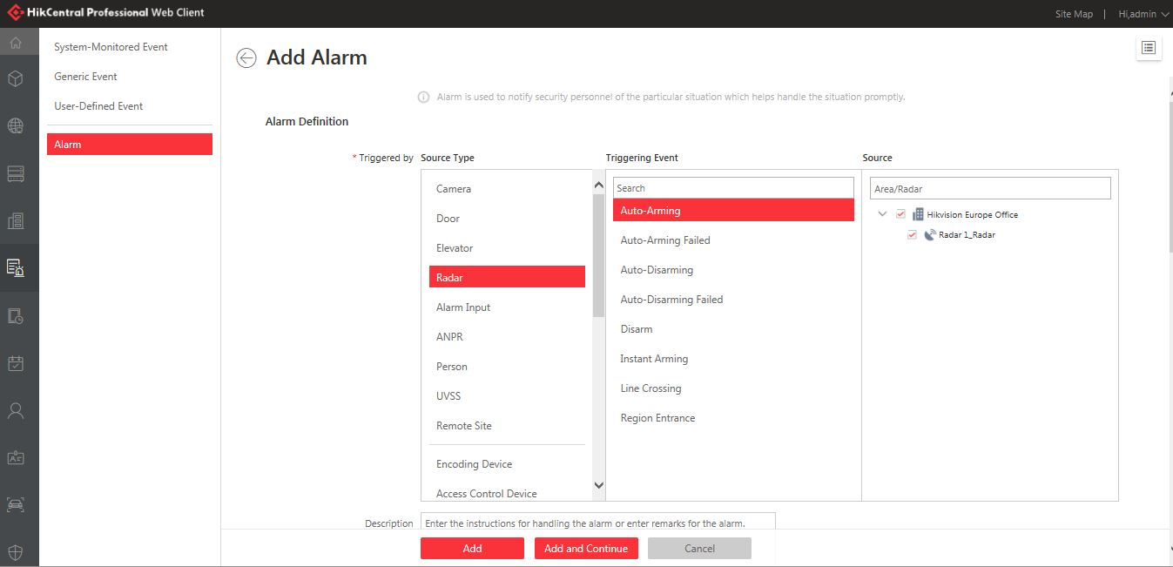
Radar
Alarm Event Setting
1. Add Radar Device
2. Add Map and relate PTZ camera
3. Draw Zone and Calibrate PTZ camera
4. Configure Event/Alarm
5. Check Live Track on the Map
6. Check Alarm Info & History Track
7. Manually Arm/Disarm(Optional)
Configure Alarm for Radar – choose triggering event and source then enable linkage actions like pop-up window, display on smart wall, etc.
Notes:
Attention the linkage actions for alarm and event are different, and only alarm notification will be showed in alarm center.

Slide 22
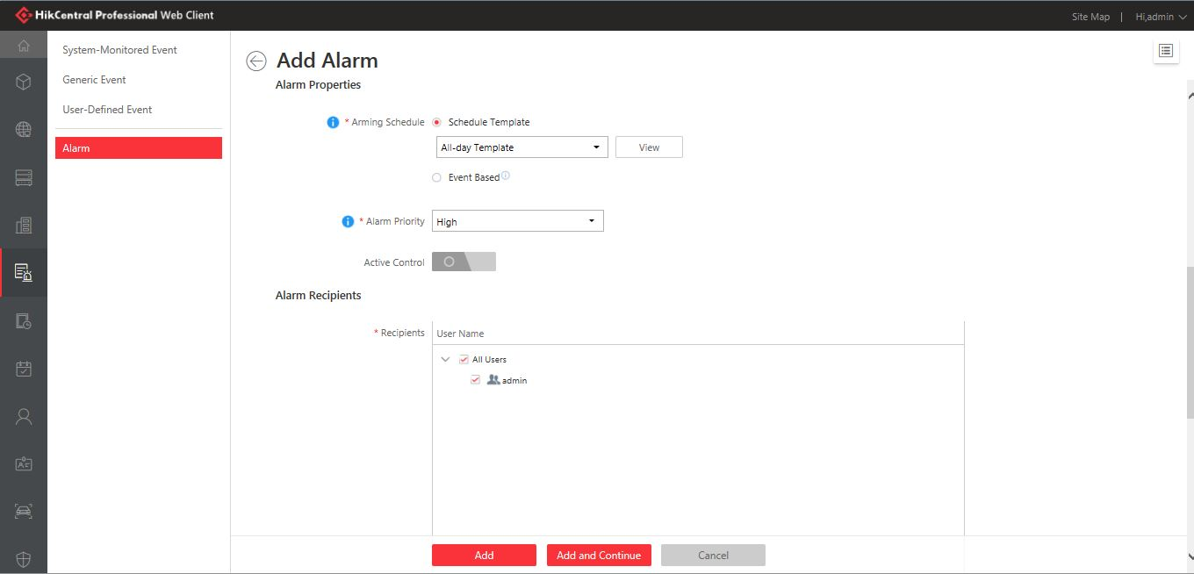
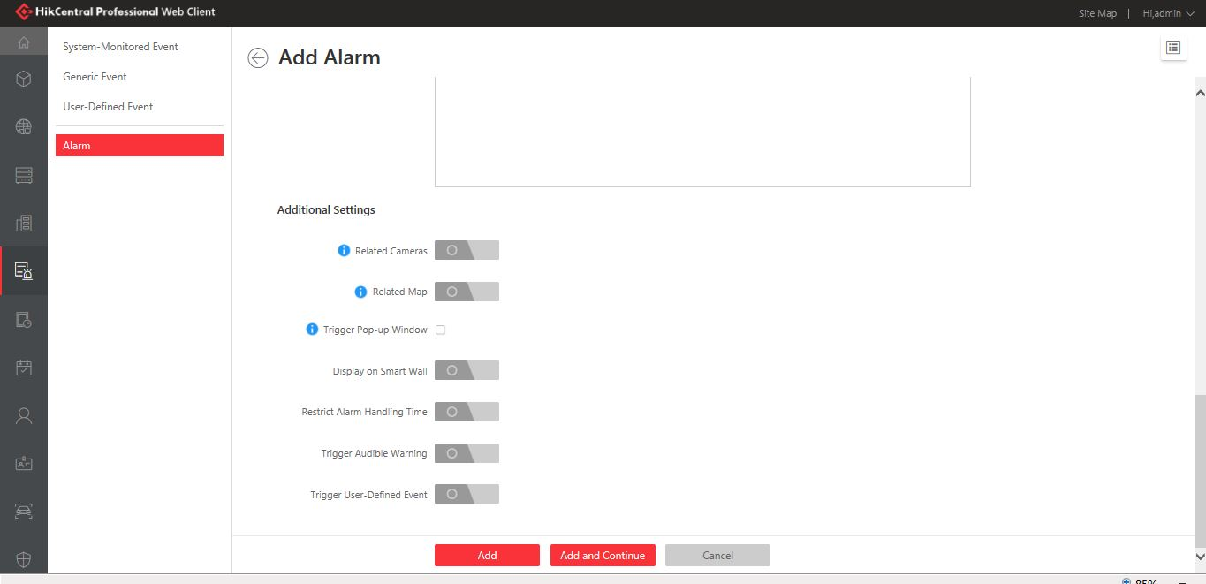
Radar
Alarm Event Setting
1. Add Radar Device
2. Add Map and relate PTZ camera
3. Draw Zone and Calibrate PTZ camera
4. Configure Event/Alarm
5. Check Live Track on the Map
6. Check Alarm Info & History Track
7. Manually Arm/Disarm(Optional)
Configure Alarm for doors – choose triggering event and source then enable linkage actions like pop-up window, display on smart wall, etc.
Notes:
Arming Schedule: Event occurred during the arming schedule will be triggered as alarm and notify the user.
Alarm Priority: Define the priority for the alarm as the reference when handling alarms in Control Client.
Related Map: Select the alarm source's related map. When viewing the alarm information, you can view the alarm source's location on the map.
Trigger Pop-up Window: Select to pop up the alarm window on Control Client to display all the alarm related cameras' live videos and playback when alarm occurs.

Slide 23
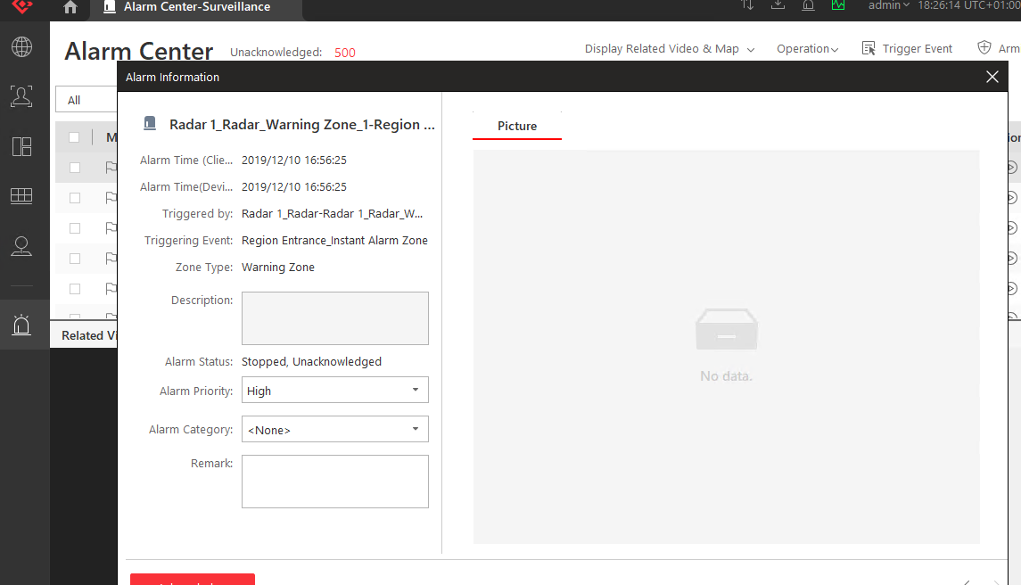
Radar
Alarm Event Setting
1. Add Radar Device
2. Add Map and relate PTZ camera
3. Draw Zone and Calibrate PTZ camera
4. Configure Event/Alarm
5. Check Live Track on the Map
6. Check Alarm Info & History Track
7. Manually Arm/Disarm(Optional)
After configuration of alarms, you can check alarm details in the alarm center of control client.

Slide 24
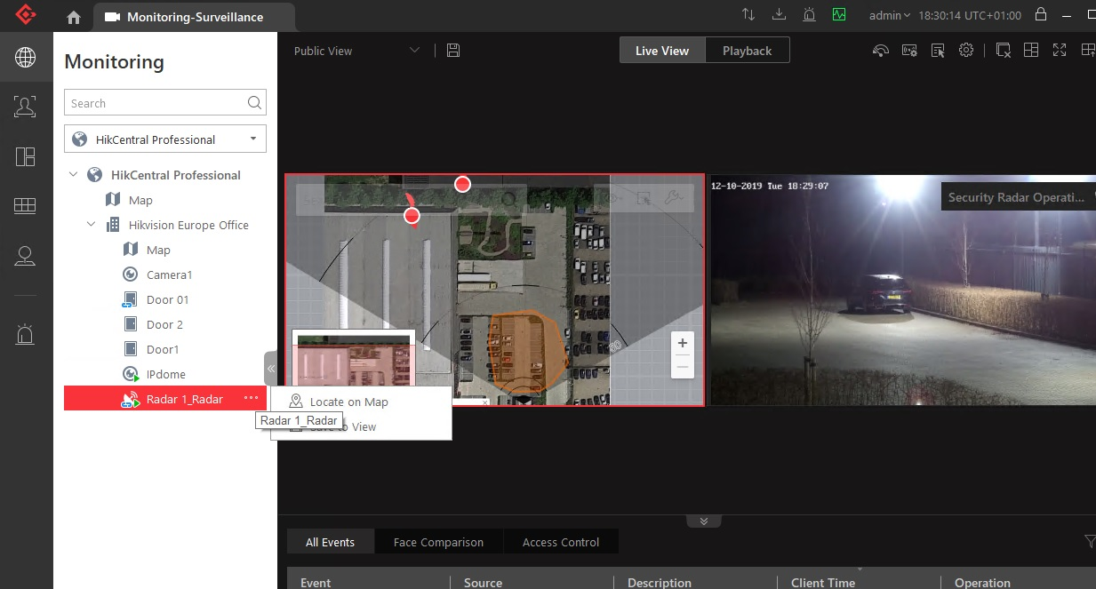
Radar
Live Track On The Map
1. Add Radar Device
2. Add Map and relate PTZ camera
3. Draw Zone and Calibrate PTZ camera
4. Configure Event/Alarm
5. Check Live Track on the Map
6. Check Alarm Info & History Track
7. Manually Arm/Disarm(Optional)
Go to HikCentral Client- Monitoring-Choose the radar-locate on map, then, you can find trajectories in the map.

Slide 25
Radar
Live Track Video
1. Add Radar Device
2. Add Map and relate PTZ camera
3. Draw Zone and Calibrate PTZ camera
4. Configure Event/Alarm
5. Check Live Track on the Map
6. Check Alarm Info & History Track
7. Manually Arm/Disarm(Optional)
Go to HikCentral Client- Monitoring-Choose the radar-locate on map

Slide 26
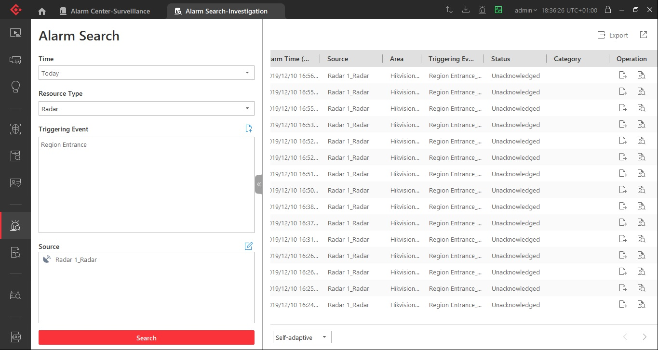
Radar
Alarm Search
1. Add Radar Device
2. Add Map and relate PTZ camera
3. Draw Zone and Calibrate PTZ camera
4. Configure Event/Alarm
5. Check Live Track on the Map
6. Check Alarm Info & History Track
7. Manually Arm/Disarm(Optional)
Go to HikCentral Client- alarm search-Choose the radar- region entrance , then, you can find the related alarm events.

Slide 27
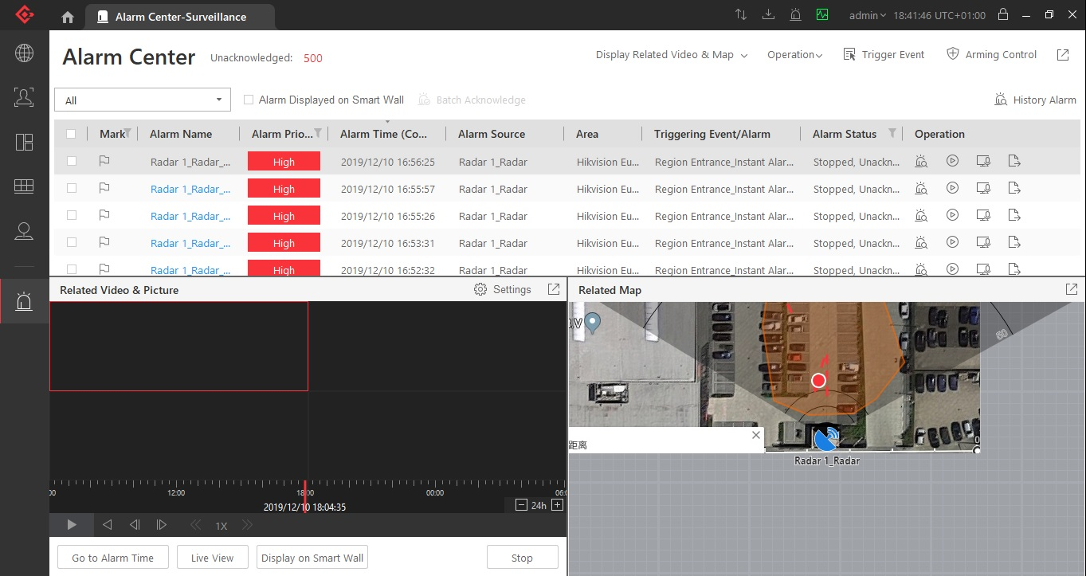
Radar
History Track
1. Add Radar Device
2. Add Map and relate PTZ camera
3. Draw Zone and Calibrate PTZ camera
4. Configure Event/Alarm
5. Check Live Track on the Map
6. Check Alarm Info & History Track
7. Manually Arm/Disarm(Optional)
Go to HikCentral Client- alarm alarm-Choose the event- click linked action, then, you can find the history track and corresponding video.

Slide 28
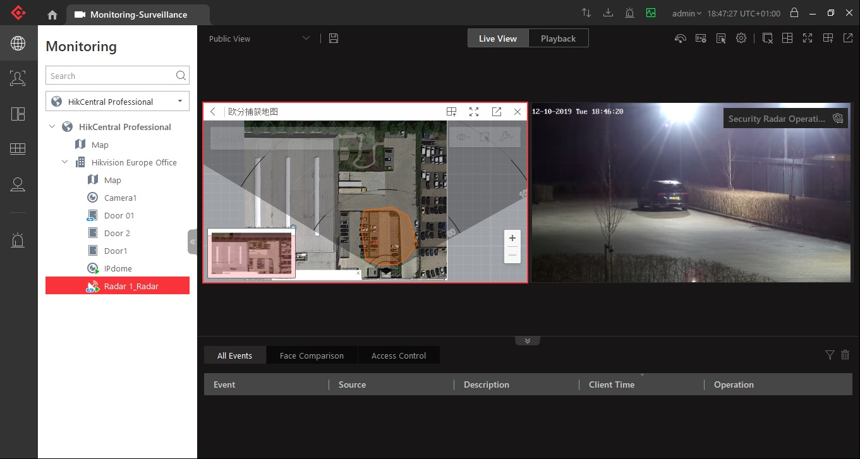
Radar
Arm or Disarm Operation
1. Add Radar Device
2. Add Map and relate PTZ camera
3. Draw Zone and Calibrate PTZ camera
Arm or Disarm
4. Configure Event/Alarm
5. Check Live Track on the Map
6. Check Alarm Info & History Track
7. Manually Arm/Disarm(Optional)
Normally, check the status and tracking in the monitoring module of hikcentral client, if you want to arm or disarm radar manually, please find the icon in the picture above.
Notes:
After you adding the radar, HikCentral keeps arming the radar. If you want to do some configuration in radar local web page, please disarm first.

