Slide 1
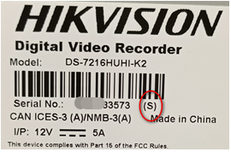
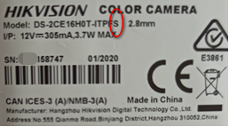
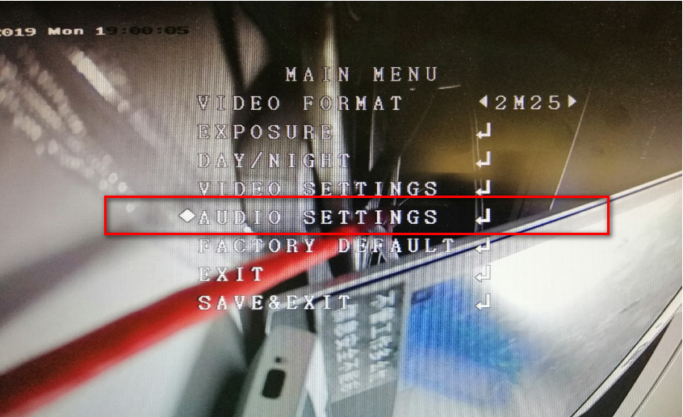
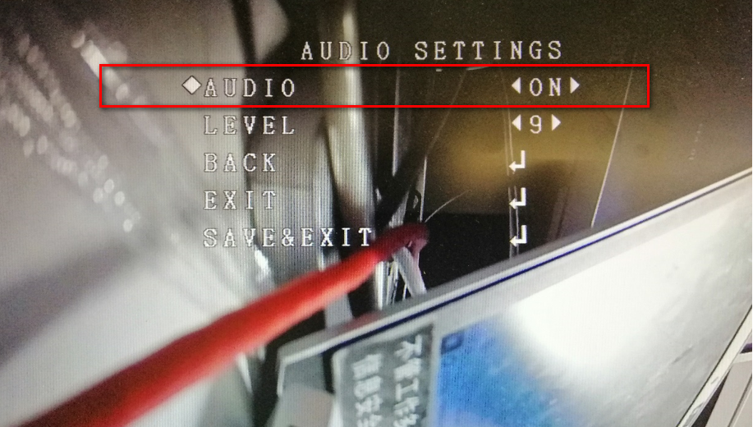
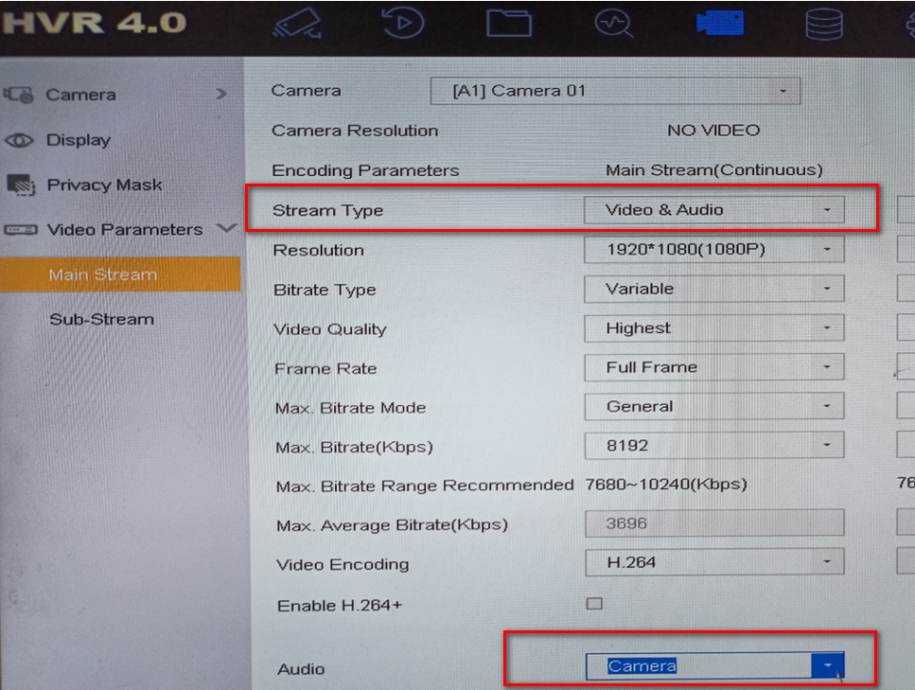
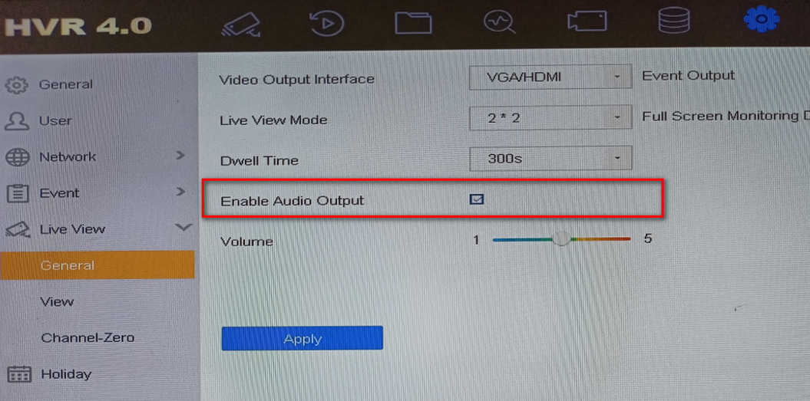
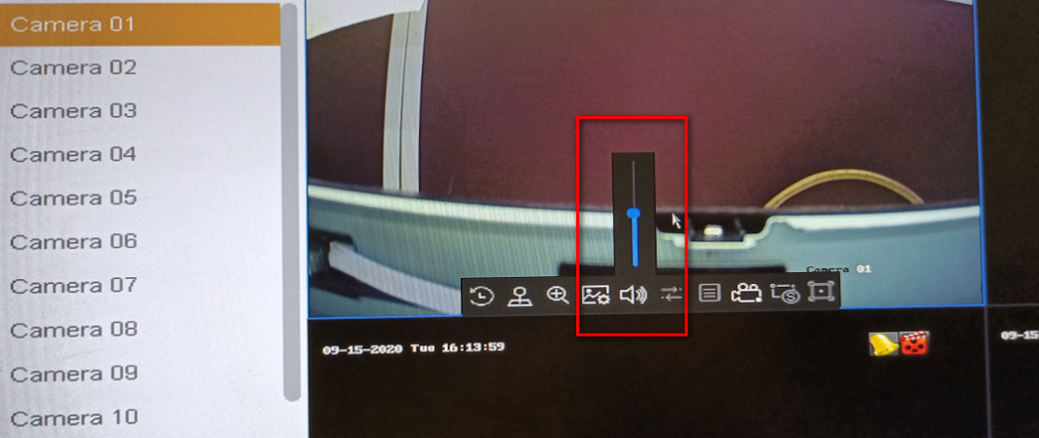
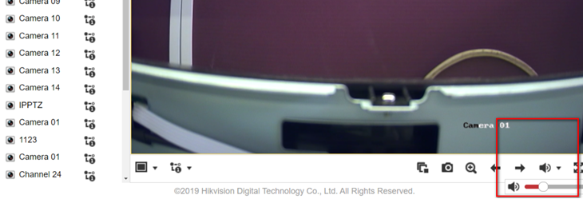
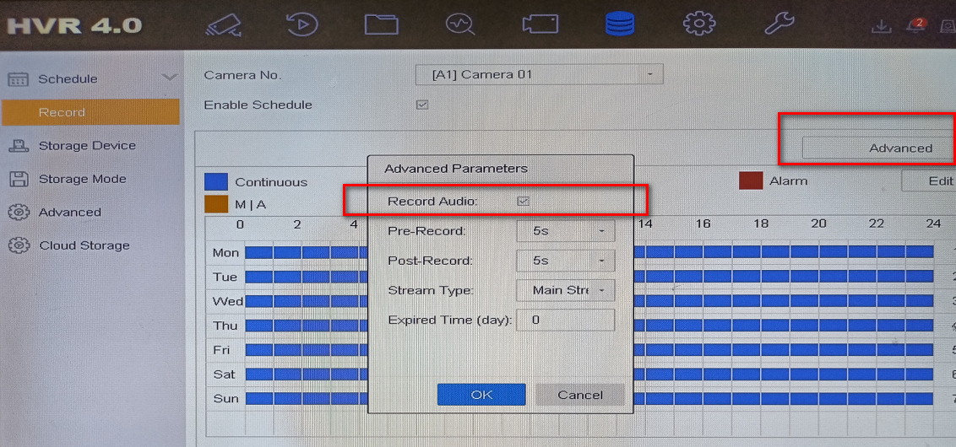
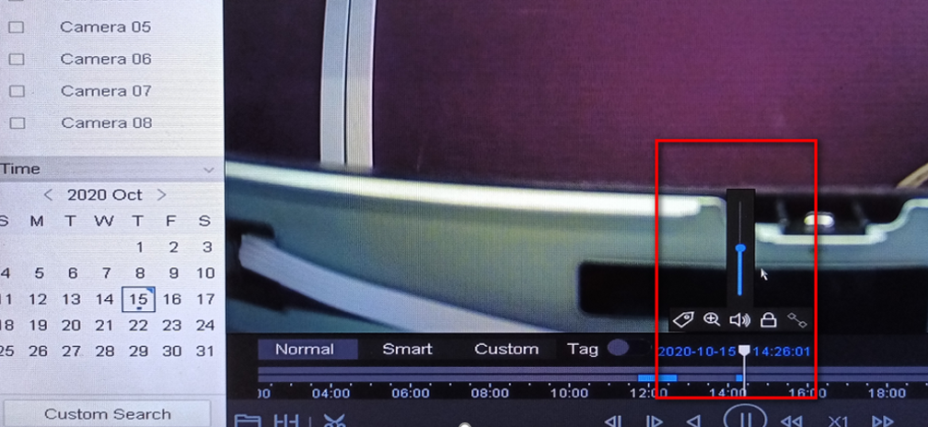
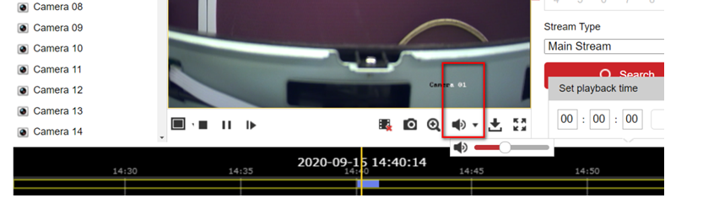
How to Use DVR Coaxial Audio Preview and Playback Function
Applicable models:
It is required that DVR and analog camera should support coaxial audio function, and the firmware version of DVR should be V4.21.000 or above.
The label pictures of DVR and analog camera which have (S) as below indicate that coaxial audio function is supported.
Common applicable models:
Basic settings
Connect the analog camera and DVR with coaxial cable.
Log in to the local GUI of DVR, configure and enable the audio function of camera through OSD menu.
Set the camera access stream type as audio & video type then select the audio option as camera.
Configure DVR coaxial audio preview function
Enter the live view setting interface then enable audio.
Turn on the sound
Method1, on local GUI preview interface (A monitor which supports HDMI audio playing is required)
Method 2, on DVR web page preview interface
Configure DVR coaxial audio recording and play back audio
Enable audio in recording schedule and recording schedule.
Turn on the sound
Method 1, on local GUI playback (A monitor which supports HDMI audio playing is required)
Method 2, log in to web page of DVR to play the recording sound.

