Slide 1
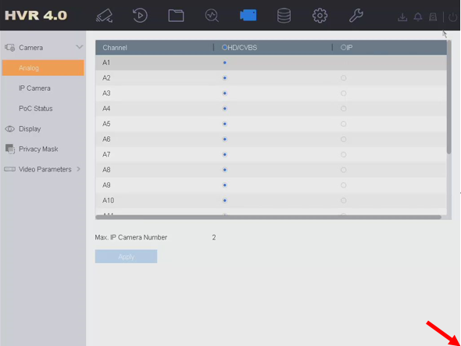
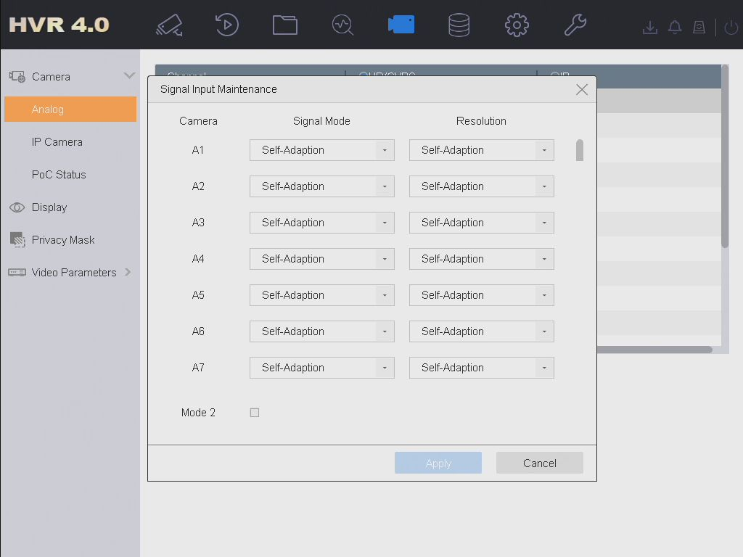
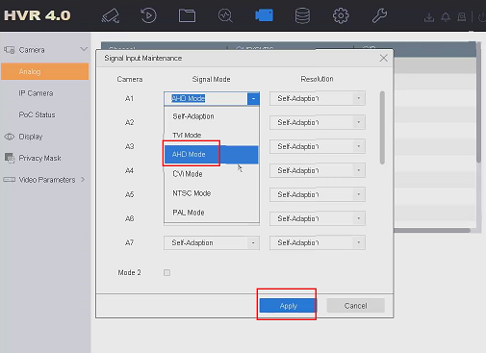
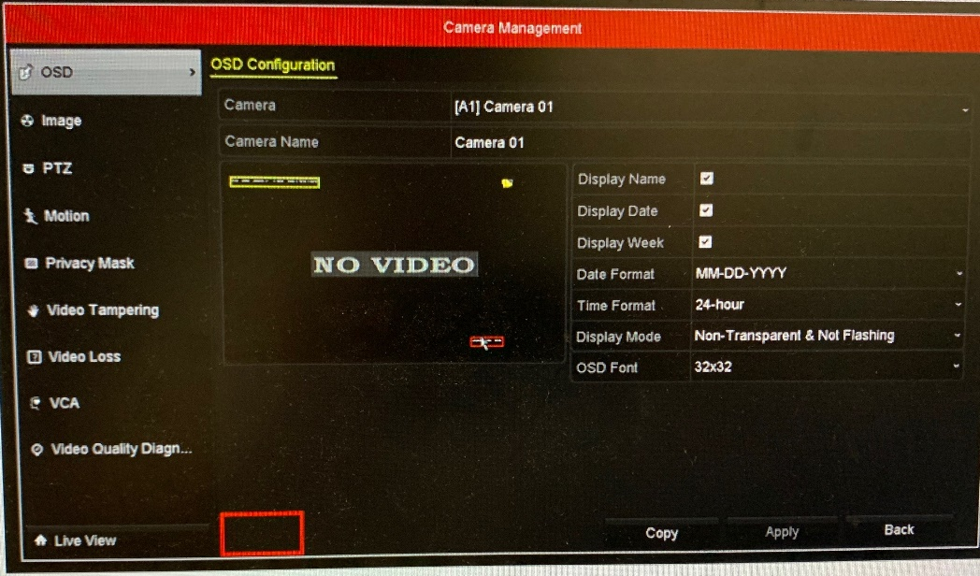
How to change the channel signal type
Preparation:
When third party camera connect to Hikvision DVRS, if the signal from camera is not standard, DVRs may analyze it incorrectly (like judge the TV signal as AHD signal) and output abnormal image.
Note: changing signal type of channel is a hidden function, mainly used for solving problem. This function can be achieved in local Gul only, web or client are not supported.
Supported version: V3.4.75 or above
Steps:
1. Go to local GUI—Camera—Analog. Move the mouse cursor to the lower right corner until the cursor disappears, then double-click the left button.
2. The interface will pop up a window of signal input maintenance.
3. Change the signal mode to the one that camera is, and click apply.
Note:GUI3.0 is as follows

