Slide 1
HikCentral Pro and Fall Detection Radar Configuration

Slide 2

01
Radar Configuration Overview
02
Radar Installation
CONTENTS
03
Firmware Upgrade and Parameter Settings
04
Network Configuration
05
Platform Configuration and Application

Slide 3


P.01
Radar Configuration Overview

Slide 4


Radar Configuration Process
To use the fall detection radar , please follow the steps below:
Configuration Process
Install the radar on the wall and power up
Check/Update Wifi/Radar firmware version via
RadarPC tool
Use the tool to configure the network
Add Radar to the HCP platform

Slide 5
01
Software Preparation
Software version:
Program | Version
IRS60-3 Fall Detection Tool | 3.x.x
Radar Firmware | 3.x.x
WIFI Firmware | 3.x.x
HikCentral Pro | 2.1.1_20211229
Please download the latest software version
https://one.hikvision.com/#/link/0vc38Q3KqaBiWtkMwRni password：tFQM
ftp://hikftp.hikvision.com:400/Product File(Overseas)/00 Oversea Products/04 Mobile & Traffic//04 Firmware& Software/02 Traffic/

Slide 6
P.02
Radar Installation

Slide 7



01
2.1 Radar Installation
Choose a wall with no obstructions in front.
The radar is installed at a height of 2m and the detection area is centered horizontally
The rear of the radar panel is close to the wall. Ensure that the front of the radar panel is tilted down by 45°.
There is an upward arrow on the panel perpendicular to the horizontal line.

Slide 8
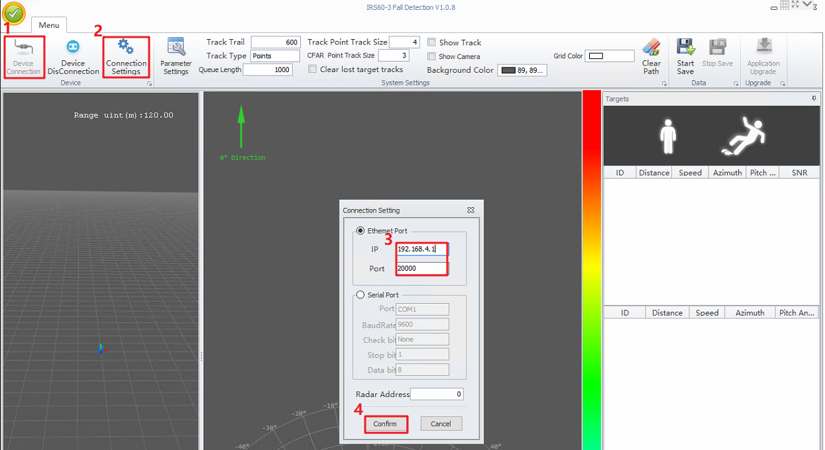
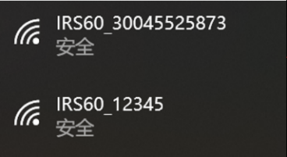
01
2.2 RadarPC: IRS60-3 Fall detection tool
RadarPC is a tool that can connect to radar, receive and view data from radar, upgrade firmware and configure radar network.
Radar Connection Steps:
  First, power on Radar, make sure your computer is connected to Radar hotspot (name : IRS60_serial number, password : abcd1234)
  Click Device Connection and Connection Settings .
  Enter IP 192.168.4.1 (when hotspot connected), Port: 20000, then click Confirm.
(You can also enter specific Radar IP here to connect after Radar Network Configuration is done, and your computer must connected to Wi-Fi)
Note:
Please close the firewall of the operating system before operating the tool

Slide 9
P.03
Firmware Upgrade and Parameter Settings

Slide 10
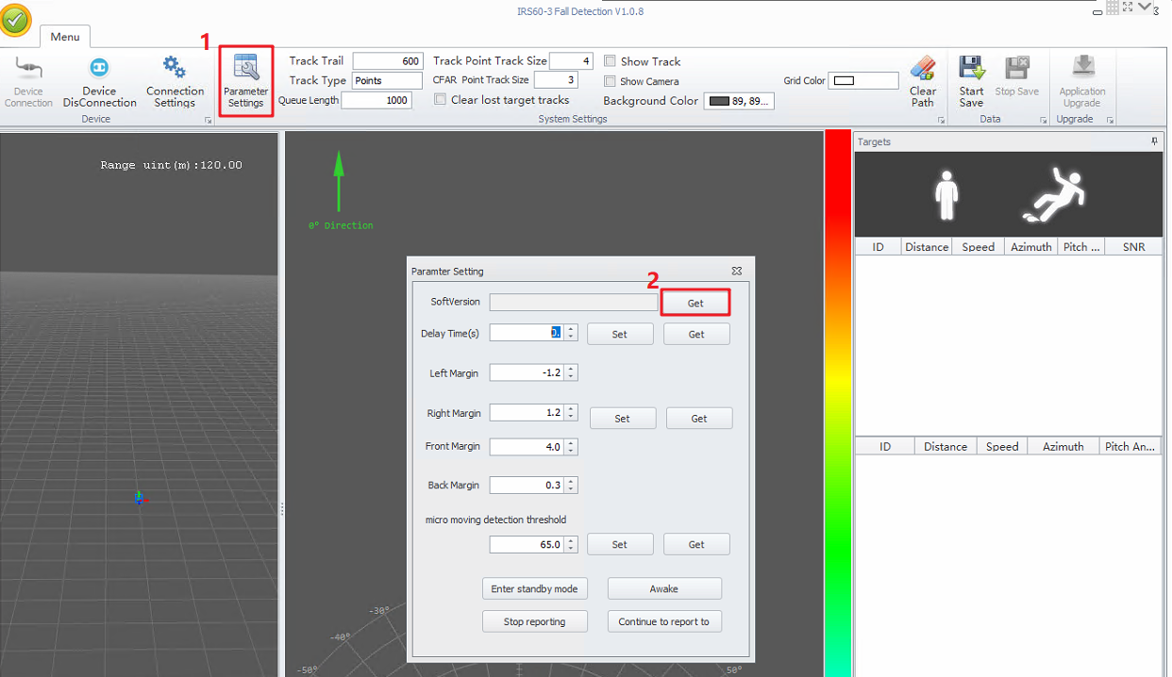
01
3.1 Firmware Upgrade
Step1 Check Radar firmware version.
  Click Parameter Settings button and Get button. you can check radar firmware version.

Slide 11
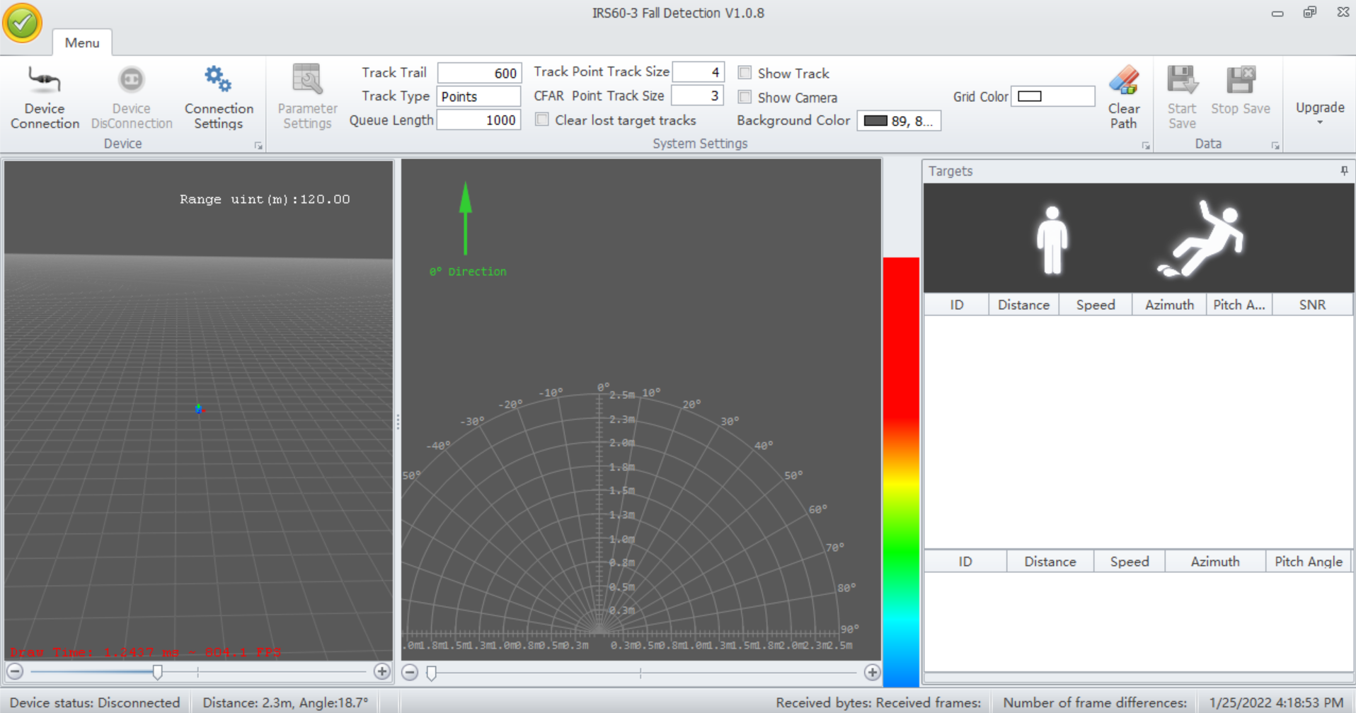
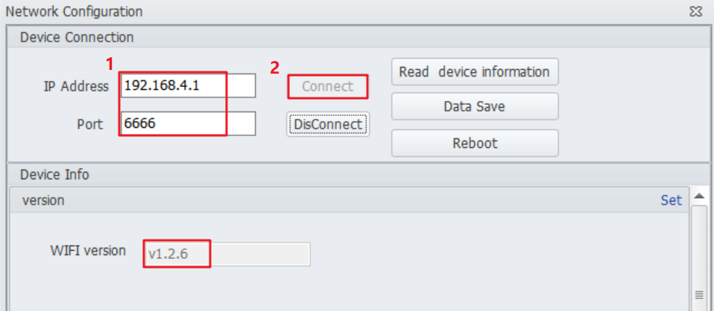
01
3.1 Firmware Upgrade
Step 2 Check wifi firmware version
  ①Click Device DisConnection Device button and press F2 on the keyboard.
  ②Enter IP address 192.168.4.1 and port 6666, then click Connect button，Check WIFI version.
Press F2
Note：If the firmware of WiFi and radar is not the latest version, please upgrade the firmware

Slide 12
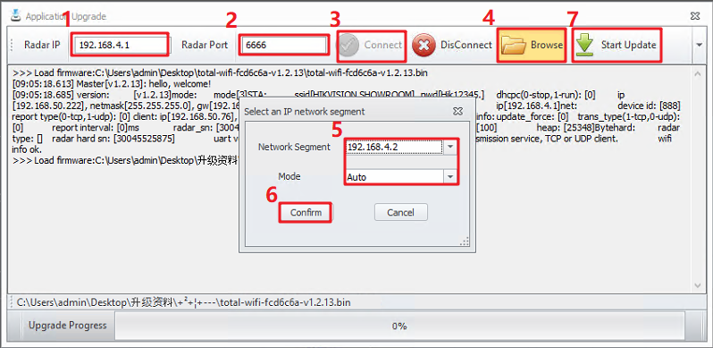
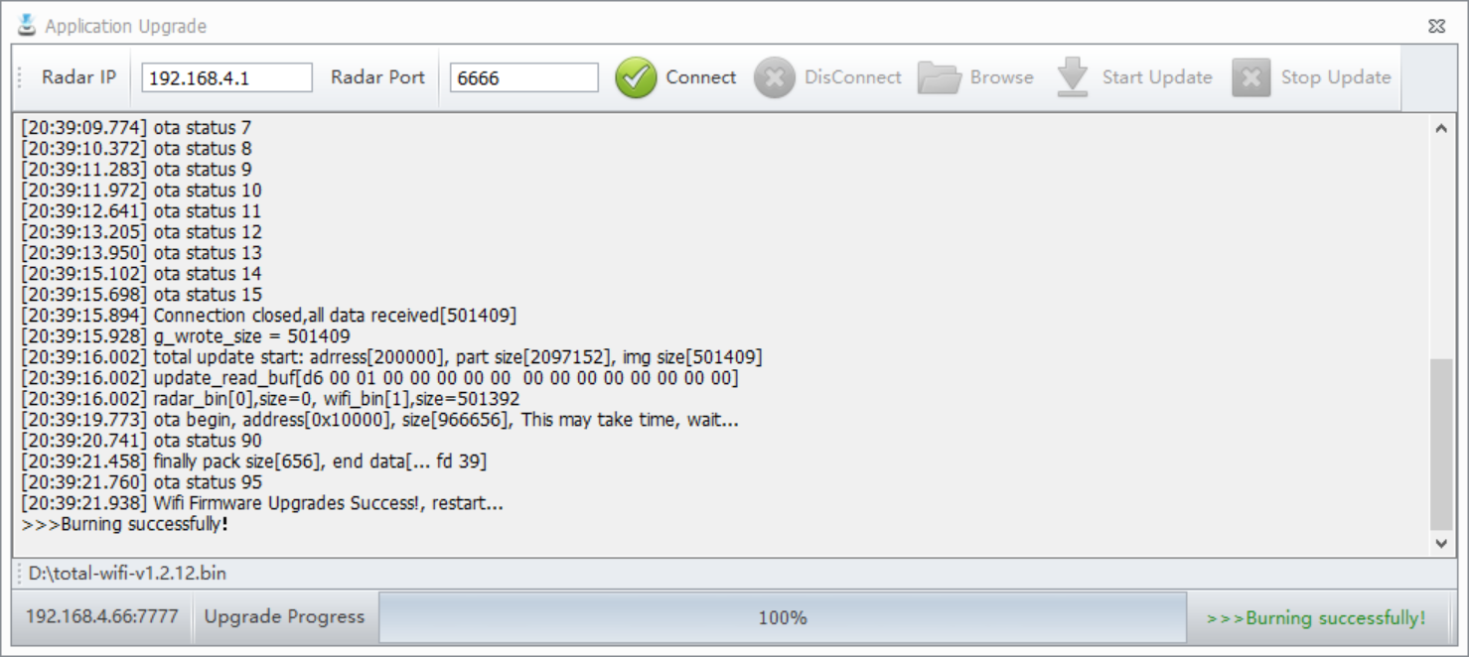
01
3.1 Firmware Upgrade
Step 3 Firmware Upgrade
① Press F1 on the keyboard.
②Enter 192.168.4.1 IP address and 6666 port, then click Connect button, browse file to select the firmware to be upgraded, then select the IP address (In the picture 1 and 5 are the IP addresses of the same network segment) and auto mode, click the confirm button and the Start Update button. Waiting for the Upgrade to succeed.
Press F1

Slide 13
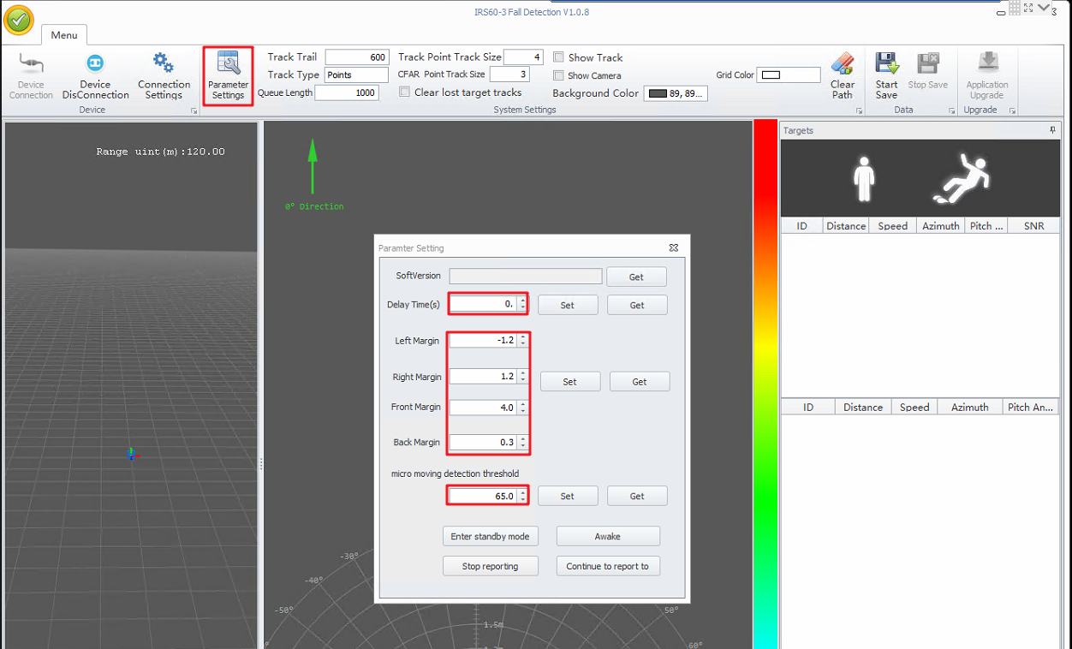
01
3.2 Parameter Settings
Click Parameter Settings. you can set parameters.
  ①Set the Delay Time parameter to 0.
  ②Set the Left Margin parameter to -1.2. Set the Right Margin parameter to 1.2. Set the Front Margin parameter to 4. Set the Back Margin parameter to 0.3.
  ③Set the micro moving detection threshold parameter to 65.

Slide 14
P.04
Network Configuration

Slide 15
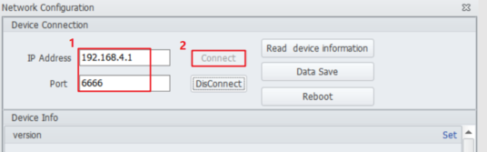
01
Radar Network Configuration
Open Radar tool, press F2. Enter IP address 192.168.4.1 and port 6666, then click Connect button. Then start network configuration.
Press F2

Slide 16
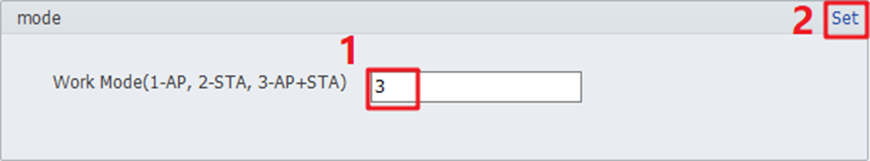
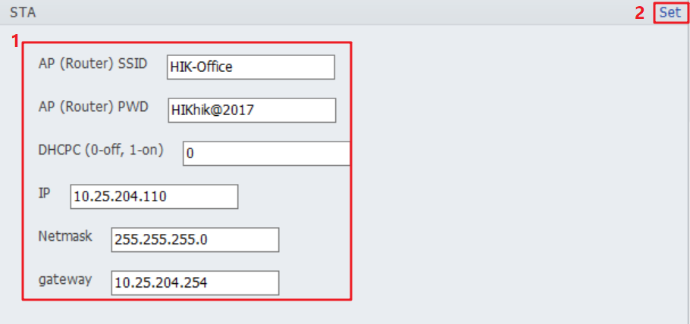
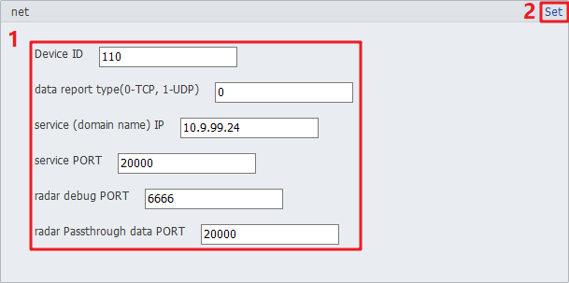
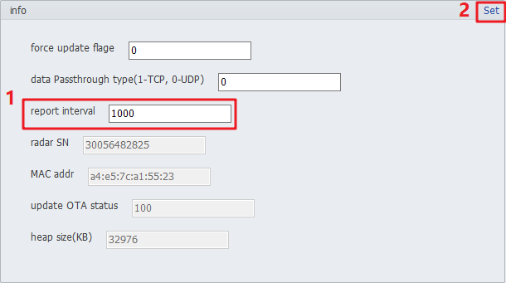
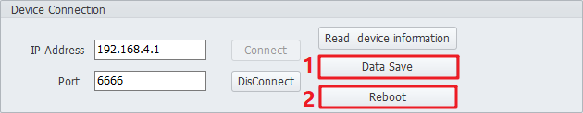
01
Radar Network Configuration
Step1 【mode】Set the Work Mode parameter to 3.
Step2 【STA】The following parameters are configured according to the actual situation
  ①Set the AP(Router) SSID parameter to router name.
  ②Set the AP(Router) PWD parameter to router password.
  ③Set the DHCP parameter to 0.
  ④Set the radar's IP, subnet mask and gateway.
Step3 【net】
  ①Set the Device ID parameter to an integer from 1 to 999999999.
  ②Set the data report type parameter to 0.
  ③Set the service IP parameter to 0.
  ④Set the service IP parameter to HCP service IP.
  ⑤Set the service PORT parameter to 20000 .
  ⑥Set the radar debug PORT parameter to 6666.
  ⑦Set the radar Passthrough data PORT parameter to 20000.
  Step4 【info】Set the Report interval parameter to 1000.
Step5 Click Data Save button and Reboot button.
Note:Click Set after modifying the parameters. After setting, step 5 must be performed.

Slide 17
P.05
Platform Configuration and Application

Slide 18
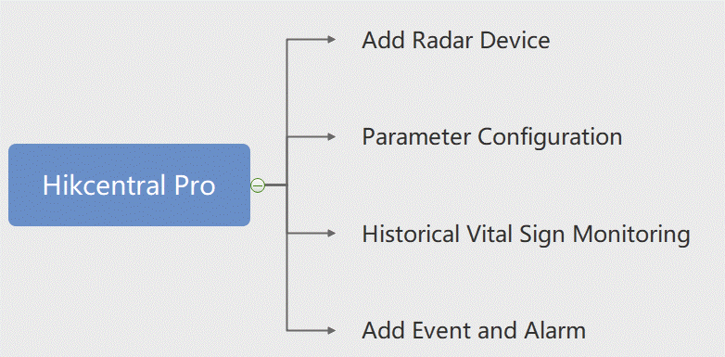
01
Hikcentral Pro

Slide 19
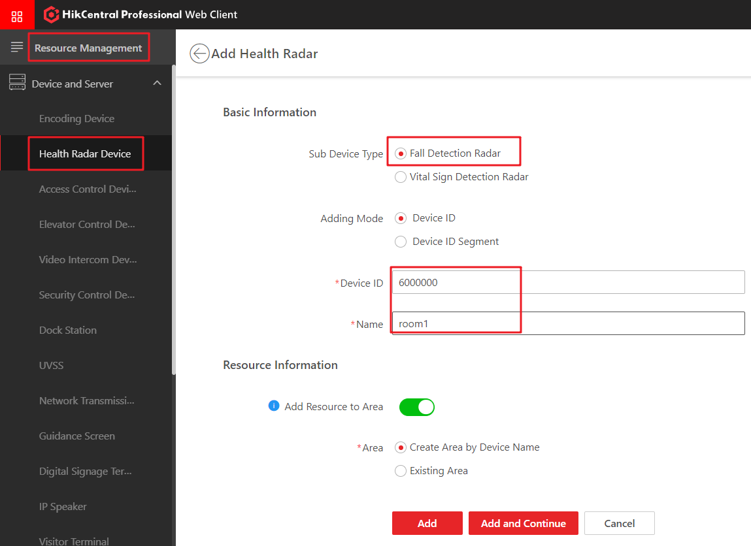
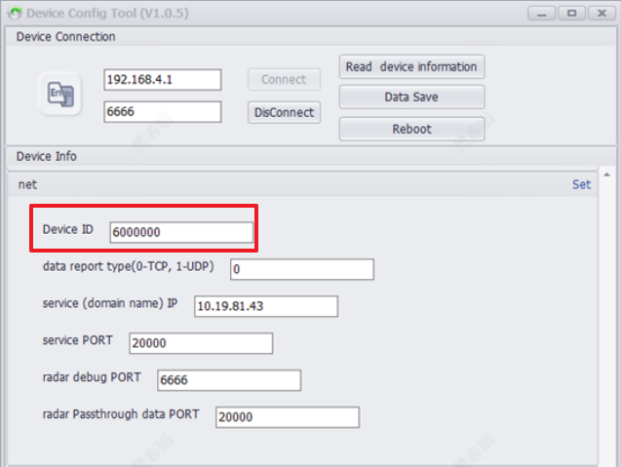
01
Add Radar Device
Step1 : Go to General→ Resource Management add the device.

Slide 20
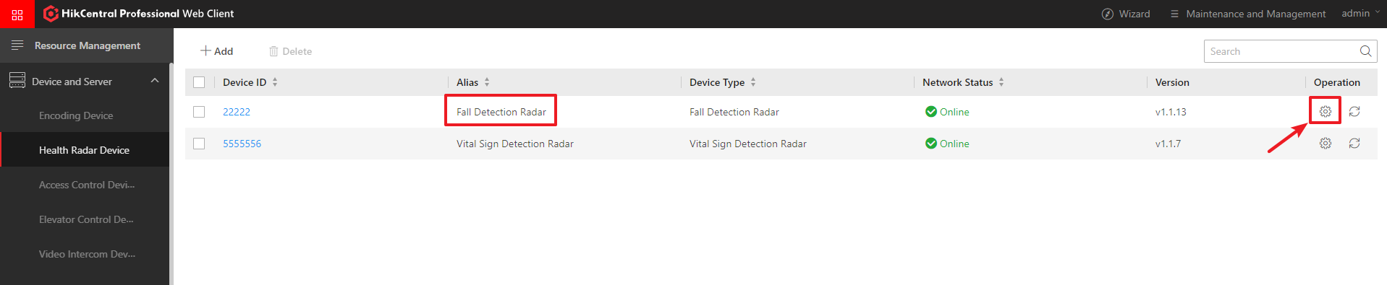
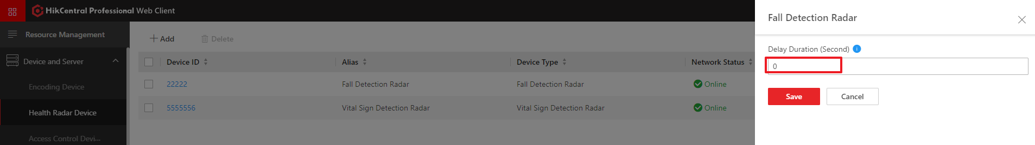
01
Parameter Configuration
Step2 : Click the configuration button, you can obtain and modify the Delay Duration(s).
Configuration button

Slide 21
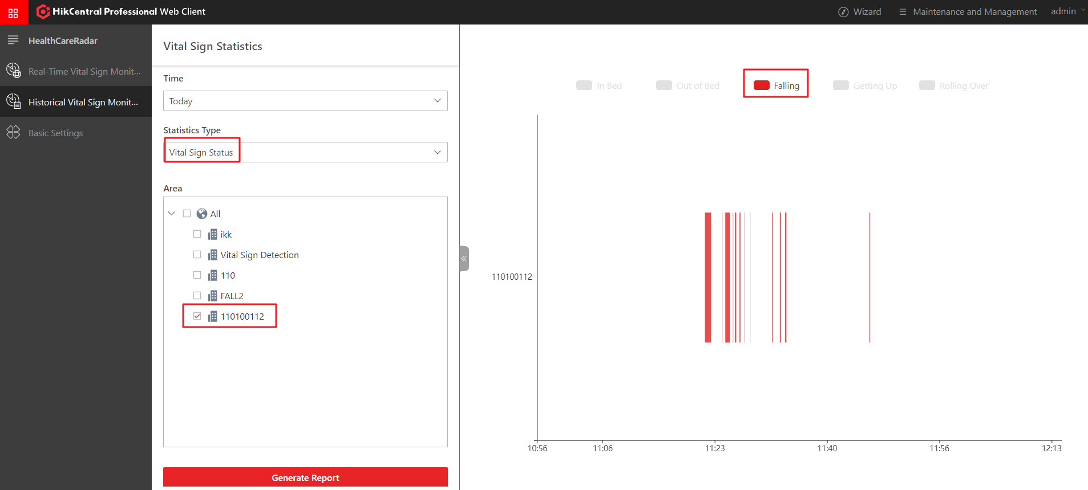
01
Historical Vital Sign Monitoring
Step3 : Go to Health Radar→ History Search, Select Vital Sign Status , you can query the historical data of fall status on any day.
Note: 1. Select up to 10 Areas 2. Support mouse wheel to zoom in and view

Slide 22
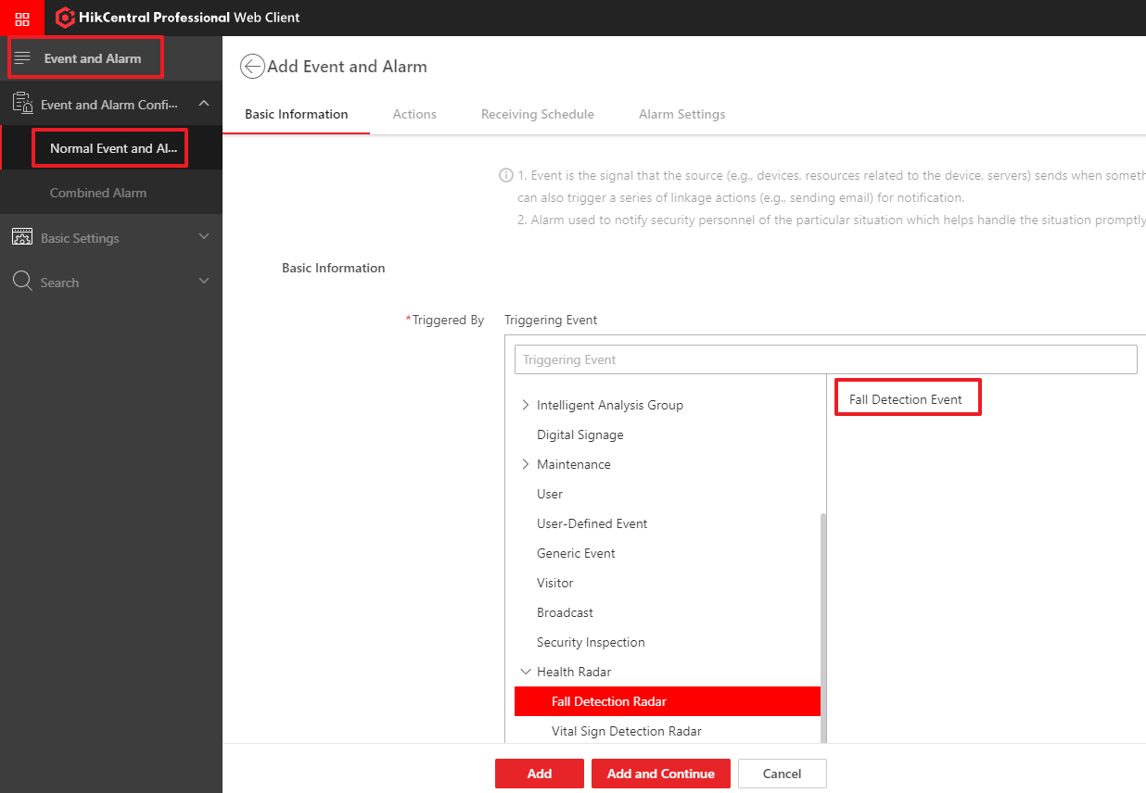
01
Add Event and Alarm
Step4 : Go to General→ Event and Alarm ,add the Fall Detection Radar alarm.

Slide 23
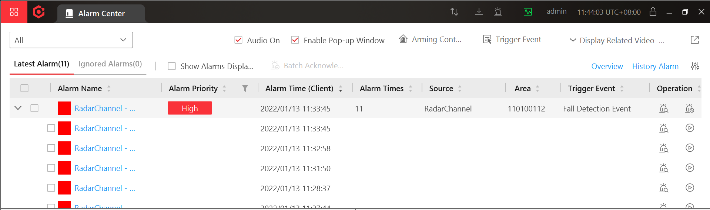
01
Alarm Information
Alarm information displayed on the control client.

Slide 24

THANK YOU
For Watching
HikCentral Professional - HealthCare

